Slide 1
Lecture 4: Motion in two dimensions
Equations for 2-d kinematics at constant acceleration
Projectile motion
Problem Solving

Slide 2
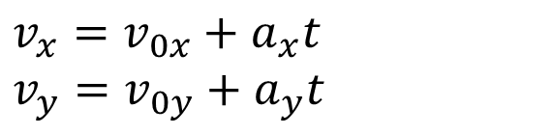
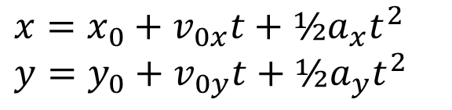
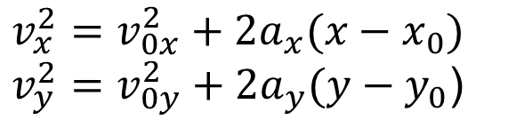
Kinematics equations
For constant acceleration:
$$x=x_{0}+v_{0x}t+½a_{x}t^{2}$$
$$y=y_{0}+v_{0y}t+½a_{y}t^{2}$$
$$v_{x}=v_{0x}+a_{x}t$$
$$v_{y}=v_{0y}+a_{y}t$$
$$v_{x}^{2}=v_{0x}^{2}+{2a}_{x}(x−x_{0})$$
$v_{y}^{2}=v_{0y}^{2}+{2a}_{y}(y−y_{0}$)

Slide 3
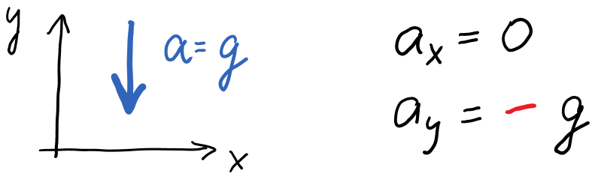
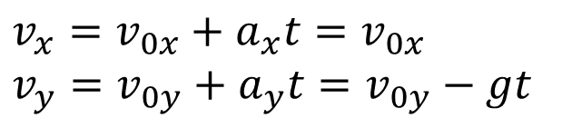
Projectile Motion
If only gravity acts on an object (free fall), then acceleration is a constant vector of magnitude g, directed down.
$$v_{x}=v_{0x}+a_{x}t=v_{0x}$$
$$v_{y}=v_{0y}+a_{y}t=v_{0y}−gt$$

Slide 4
Projectile motion: Simulation
Link to Water Fendt Projectile Simulation

Slide 5
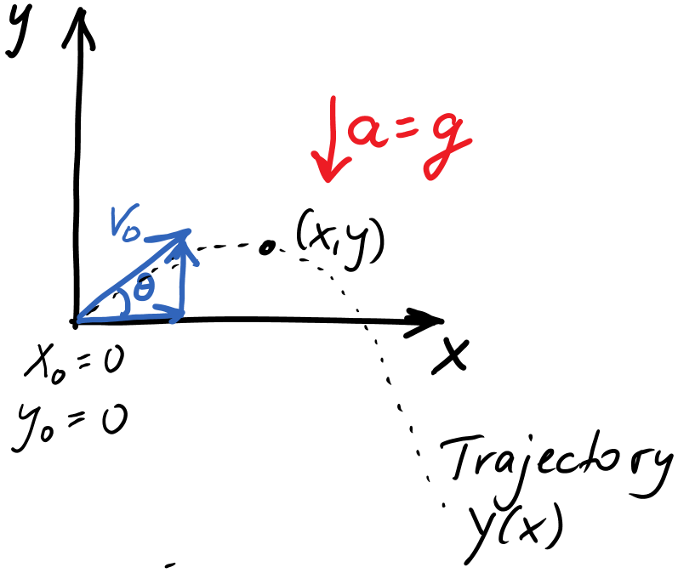


Free-fall trajectory
$$x=x_{0}+v_{0x}t+½a_{x}t^{2}$$
$$y=y_{0}+v_{0y}t+½a_{y}t^{2}$$

Slide 6
Example
A child kicks a soccer ball from the ground level with an initial speed V₀ at an angle θ with respect to the horizontal. The ball hits a wall a distance L away.
a) Complete the diagram with all information necessary to solve the parts below.
V₀
θ
L
b) Derive a symbolic expression for the time it takes the ball to reach the wall.
c) Derive a symbolic expression for the height H at which the ball hits the wall.

Slide 7
Example continued
V₀
θ
L

Slide 8
d) The ball reaches its highest point before hitting the wall. Find the maximum height above the ground.
V₀
θ
L

Slide 9
Example: Range of a Projectile

Slide 10
Demo: The hunter and the monkey

