Slide 1
Lecture 10: Work and kinetic energy
Kinetic energy
Vector dot product (scalar product)
Definition of work done by a force on an object
Work-kinetic-energy theorem

Slide 2


Kinetic energy
$$K=½mv^{2}$$
Kinetic energy is a scalar
It does not have components!
Unit: $kg {\left(\frac{m}{s}\right)}^{2}=\left(kg \frac{m}{s^{2}}\right) m=Nm=J$ Joule

Slide 3
Effect of force components
Components of force parallel
and perpendicular to velocity
have different effects.
F_{II} causes change in magnitude of velocity vector (speed)
⟹ changes kinetic energy
F ┴ causes change in direction
⟹ does not change kinetic energy

Slide 4

Dot product
We need to find a way to determine how much of
two vectors is parallel
$$\vec{A}∙\vec{B}=ABcosθ$$
Vector dot product
The dot product is a scalar.

Slide 5

$$\vec{A}∙\vec{B}=ABcosθ=A_{∥B}B={A B}_{∥A}$$
Dot product selects parallel component

Slide 6

What if θ > 90º?
$$\vec{A}∙\vec{B}=ABcosθ={A B}_{∥A}$$

Slide 7
Special cases

Slide 8


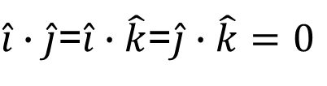
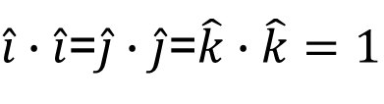

Properties of dot product
$$\vec{A}∙\vec{B}=\vec{B}∙\vec{A}$$
commutative
$$\vec{A}∙\left(\vec{B}+\vec{C}\right)=\vec{A}∙\vec{B}+\vec{A}∙\vec{C}$$
distributive
$\hat{i}∙\hat{i}$=$\hat{j}∙\hat{j}$=$\hat{k}∙\hat{k}=1$
Same unit vectors
$\hat{i}∙\hat{j}$=$\hat{i}∙\hat{k}$=$\hat{j}∙\hat{k}=0$
Orthogonal unit vectors
⟹Dot product
in components:
$$\vec{A}∙\vec{B}=A_{x}B_{x}+A_{y}B_{y}+A_{z}B_{z}$$

Slide 9
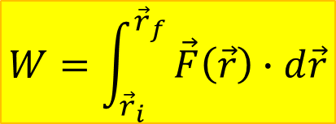
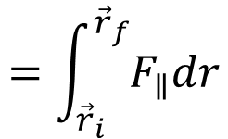
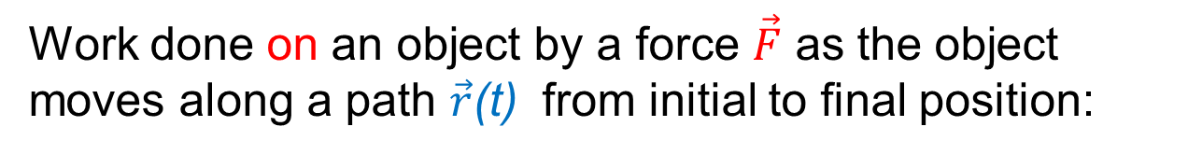
Work
Work done on an object by a force $\vec{F}$ as the object moves along a path $\vec{r}$(t) from initial to final position:
$$W=\int_{{\vec{r}}_{i}}^{{\vec{r}}_{f}}{\vec{F}\left(\vec{r}\right)∙d\vec{r}}$$
$$=\int_{{\vec{r}}_{i}}^{{\vec{r}}_{f}}{F_{∥}dr}$$
Selects component of force parallel to path, i.e. parallel to velocity, which changes kinetic energy
Force can vary in magnitude and direction along the path

Slide 10
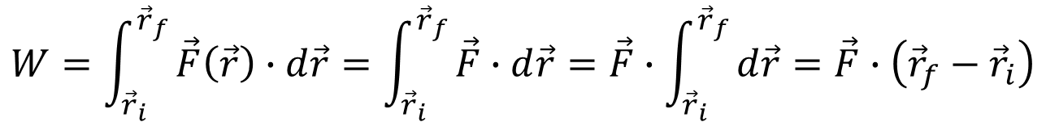
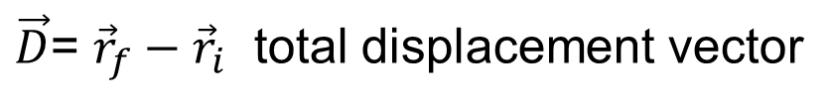

Work by constant force
$$W=\int_{{\vec{r}}_{i}}^{{\vec{r}}_{f}}{\vec{F}\left(\vec{r}\right)∙d\vec{r}}=\int_{{\vec{r}}_{i}}^{{\vec{r}}_{f}}{\vec{F}∙d\vec{r}=\vec{F}∙\int_{{\vec{r}}_{i}}^{{\vec{r}}_{f}}{d\vec{r}=\vec{F}∙\left({\vec{r}}_{f}−{\vec{r}}_{i}\right)}}$$
$$W=\vec{F}∙\vec{D}$$
$\vec{D}$= ${\vec{r}}_{f}−{\vec{r}}_{i}$ total displacement vector
Caution: Force must be constant in magnitude and direction

Slide 11
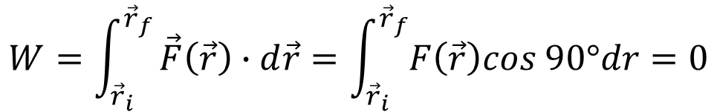
Force perpendicular to path
If force is perpendicular to the path at every point*
$$W=\int_{{\vec{r}}_{i}}^{{\vec{r}}_{f}}{\vec{F}\left(\vec{r}\right)∙d\vec{r}}=\int_{{\vec{r}}_{i}}^{{\vec{r}}_{f}}{F\left(\vec{r}\right)cos 90°dr=0}$$
*whether constant in magnitude or not

Slide 12
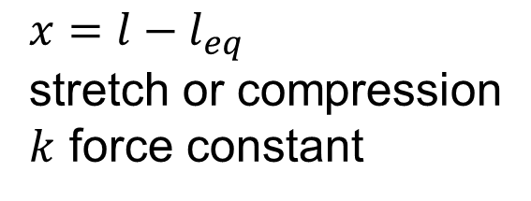
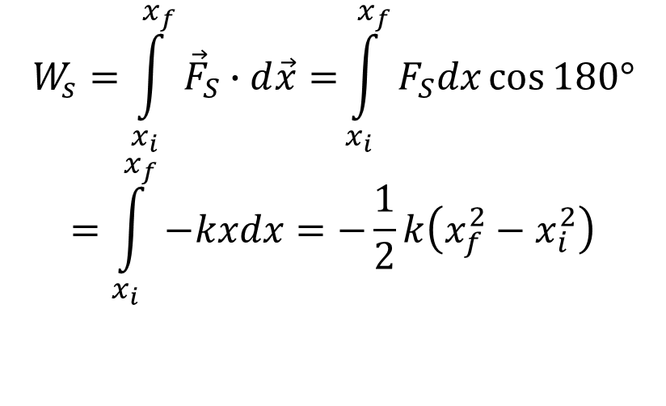

Work done by a spring
Spring force: $F_{S x}=−kx$
$x=l−l_{eq}$
stretch or compression
$k$ force constant
$$W_{s}=\int_{x_{i}}^{x_{f}}{{\vec{F}}_{S}∙d\vec{x}=}\int_{x_{i}}^{x_{f}}{F_{S}dx\cos{180°}}$$
$$=\int_{x_{i}}^{x_{f}}{−kxdx=−\frac{1}{2}k\left(x_{f}^{2}−x_{i}^{2}\right)}$$

Slide 13

Net Work
Work done by the net force on object as it moves
along path.
But also (and easier to calculate):
Sum of work done by all individual forces
$$W_{net}=ΣW_{n}$$

Slide 14
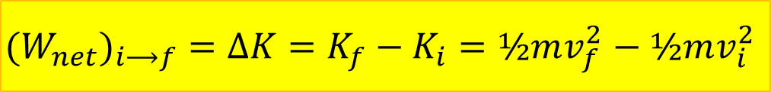
Work-Kinetic Energy-Theorem
Work = effect of force component parallel to velocity
⟹ changes kinetic energy
$${(W}_{net})_{i⟶f}=ΔK=K_{f}−K_{i}=½mv_{f}^{2}−½mv_{i}^{2}$$

Slide 15
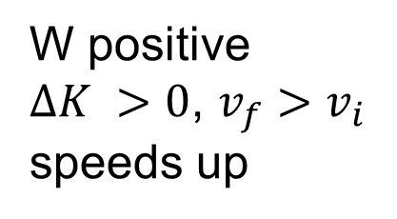
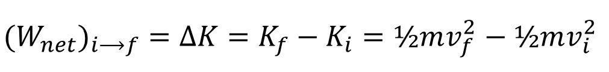
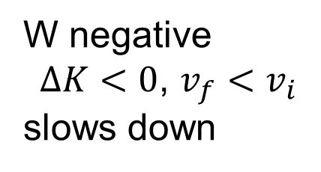
Sign of work
$${(W}_{net})_{i⟶f}=ΔK=K_{f}−K_{i}=½mv_{f}^{2}−½mv_{i}^{2}$$
Consider one single force acting on object
W positive
$ΔK >0$, $v_{f}>v_{i}$
speeds up
W negative
$ΔK<0$, $v_{f}<v_{i}$
slows down

Slide 16
Example
A block of mass M is pulled by a force of magnitude P directed at angle θ above the horizontal a distance D over a rough horizontal surface with coefficient of friction μ. Determine the change in the block’s kinetic energy.

