Slide 1
Lecture 11: Potential energy
Conservative and non-conservative forces
Potential energy
Total mechanical energy
Energy conservation

Slide 2
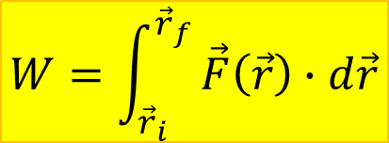
Conservative forces
$$W=\int_{{\vec{r}}_{i}}^{{\vec{r}}_{f}}{\vec{F}\left(\vec{r}\right)∙d\vec{r}}$$
A force is called conservative if the work it does on an object as the object goes between two points is independent of the path.
⟶ The work done by a conservative force along any two paths between the same two points is the same.

Slide 3
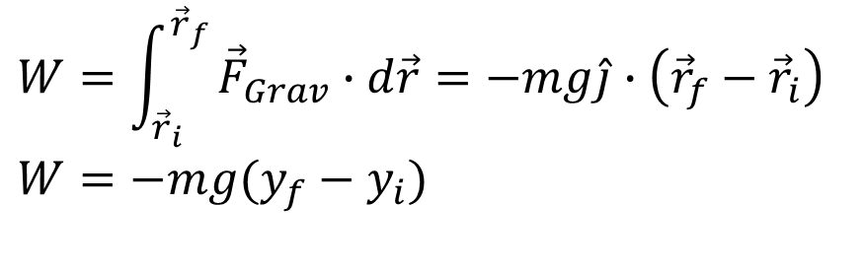
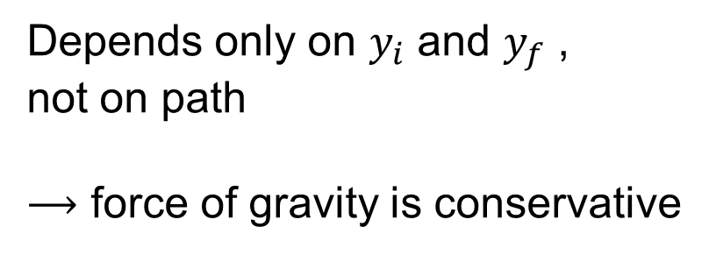
Example: Work done by gravity
$$W=\int_{{\vec{r}}_{i}}^{{\vec{r}}_{f}}{{\vec{F}}_{Grav}∙d\vec{r}=−mg\hat{j}∙\left({\vec{r}}_{f}−{\vec{r}}_{i}\right)}$$
$$W=−mg(y_{f}−y_{i})$$
Depends only on $y_{i}$ and $y_{f}$ ,
not on path
⟶ force of gravity is conservative

Slide 4

Properties of conservative forces:
Reverse path, get negative:
$$W_{A→B}=−W_{B→A}$$
Work done over a closed path is zero:
$$W_{A→A}=\oint_{A}^{A}{\vec{F}∙d\vec{r}=0}$$

Slide 5
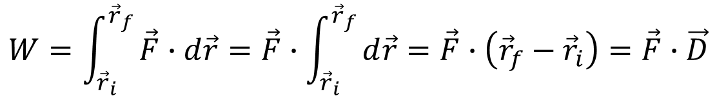
Constant forces are conservative
$$W=\int_{{\vec{r}}_{i}}^{{\vec{r}}_{f}}{\vec{F}∙d\vec{r}=\vec{F}∙\int_{{\vec{r}}_{i}}^{{\vec{r}}_{f}}{d\vec{r}=\vec{F}∙\left({\vec{r}}_{f}−{\vec{r}}_{i}\right)=\vec{F}∙\vec{D}}}$$
${\vec{D}=\vec{r}}_{f}−{\vec{r}}_{i}$ depends only on initial and final position, not path
Caution:
1. Force must be constant in magnitude and direction.
2. Not every conservative force has to be constant.

Slide 6
Non-conservative forces
If the work done by a force depends on the path, the force is non-conservative.
Different paths between initial
and final point give
different amount of work
Work for closed path is not zero.
HW: examine frictional force

Slide 7
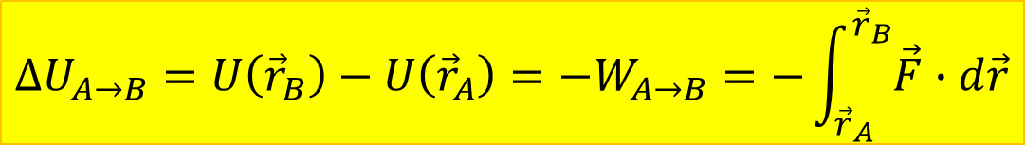
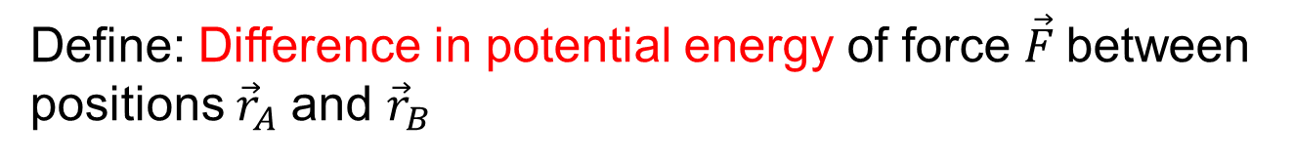
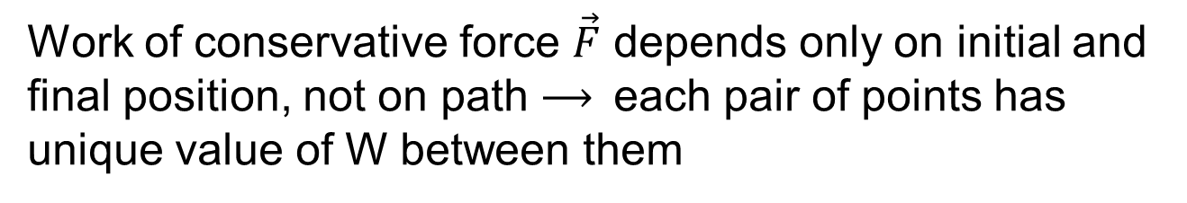
Potential energy difference: definition
Work of conservative force $\vec{F}$ depends only on initial and final position, not on path ⟶ each pair of points has unique value of W between them
Define: Difference in potential energy of force $\vec{F}$between
positions ${\vec{r}}_{A}$ and ${\vec{r}}_{B}$
$$ΔU_{A→B}=U\left({\vec{r}}_{B}\right)−U\left({\vec{r}}_{A}\right)=−W_{A→B}=−\int_{{\vec{r}}_{A}}^{{\vec{r}}_{B}}{\vec{F}∙d\vec{r}}$$

Slide 8
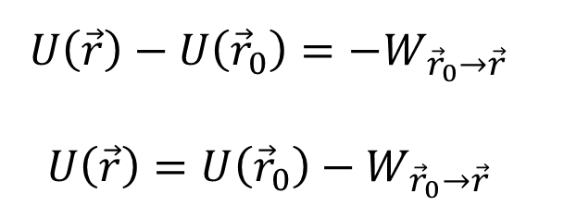
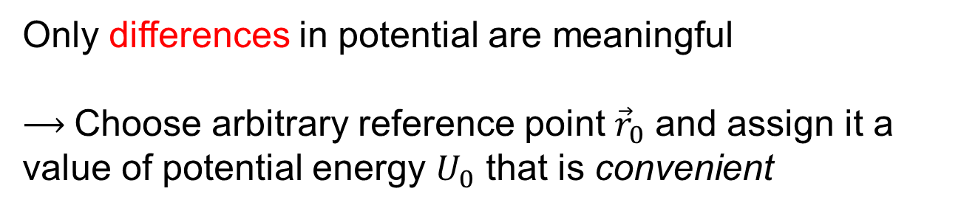
Potential energy: reference point
$$ΔU_{A→B}=U\left({\vec{r}}_{B}\right)−U\left({\vec{r}}_{A}\right)=U_{B}−U_{A}=−W_{A→B}$$
Only differences in potential are meaningful
⟶ Choose arbitrary reference point ${\vec{r}}_{0}$ and assign it a value of potential energy $U_{0}$ that is convenient
$$U\left(\vec{r}\right)−U\left({\vec{r}}_{0}\right)=−W_{{\vec{r}}_{0}→\vec{r}}$$
$$U\left(\vec{r}\right)=U\left({\vec{r}}_{0}\right)−W_{{\vec{r}}_{0}→\vec{r}}$$

Slide 9

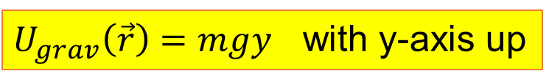
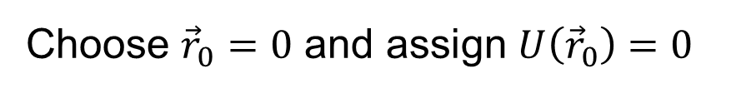
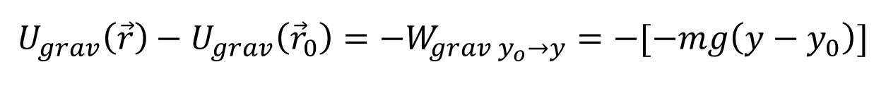
Potential energy of gravity*
*near Earth’s surface
$$W_{grav}=−mg(y_{f}−y_{i})$$
(y-axis vertically up)
$$U_{grav}\left(\vec{r}\right)−U_{grav}\left({\vec{r}}_{0}\right)=−W_{grav y_{o}→y}=−[−mg\left(y−y_{0}\right)]$$
Choose ${\vec{r}}_{0}=0$ and assign $U\left({\vec{r}}_{0}\right)=0$
$U_{grav}\left(\vec{r}\right)=mgy$ with y-axis up

Slide 11

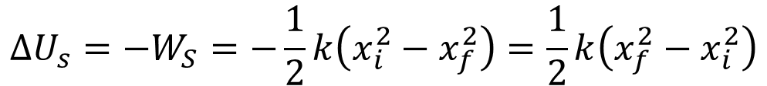
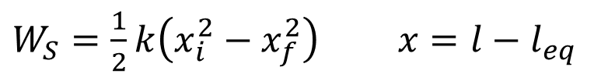

Potential energy of spring force
From lecture 10:
$W_{S}=\frac{1}{2}k\left(x_{i}^{2}−x_{f}^{2}\right)$ $x={l−l}_{eq}$
$$ΔU_{s}=−W_{S}=−\frac{1}{2}k\left(x_{i}^{2}−x_{f}^{2}\right)=\frac{1}{2}k\left(x_{f}^{2}−x_{i}^{2}\right)$$
Choose $x=0$ as reference point,
assign $U_{S}\left(x=0\right)=0$
$$U_{spring}=½kx^{2}$$

Slide 12
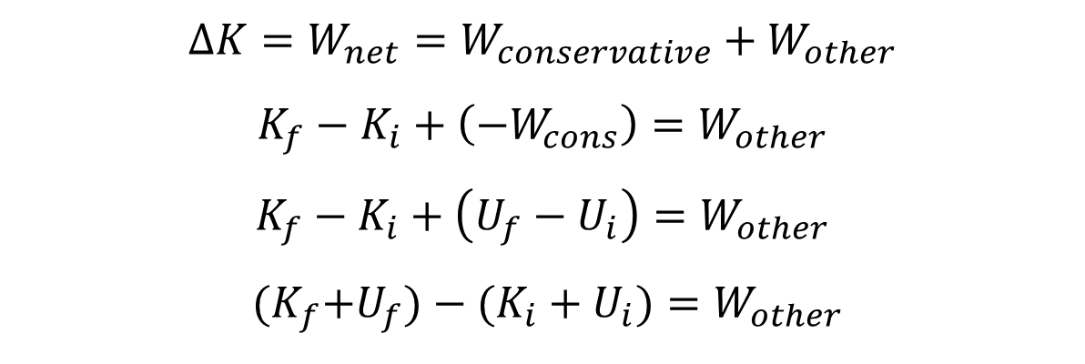
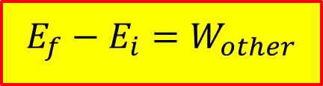
Total mechanical energy
$$∆K=W_{net}=W_{conservative}+W_{other}$$
$$K_{f}−K_{i}+\left(−W_{cons}\right)=W_{other}$$
$$K_{f}−K_{i}+\left(U_{f}−U_{i}\right)=W_{other}$$
${(K}_{f}+U_{f})−(K_{i}+U_{i})=W_{other}$
Total mechanical energy of a system: $E=K+U$
$$E_{f}−E_{i}=W_{other}$$

Slide 13
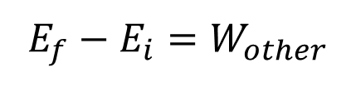
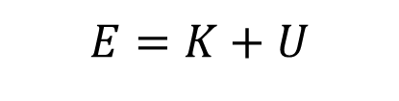
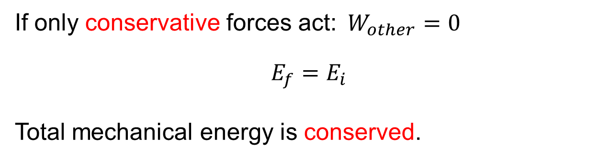
$$E=K+U$$
$$E_{f}−E_{i}=W_{other}$$
If only conservative forces act:$W_{other}=0$
$$E_{f}=E_{i}$$
Total mechanical energy is conserved.

Slide 14
Example
In a new Olympic discipline, a ski jumper of mass M is launched by means of a compressed spring of spring constant k. At the top of a frictionless ski jump at height H above the ground, he is pushed against the spring, compressing it a distance L. When he is released from rest, the spring pushes him so he leaves the lower end of the ski jump with a speed V at a positive angle θ with respect to the horizontal.
Determine the height D of the end of the ski jump in terms of given system parameters.

Slide 16
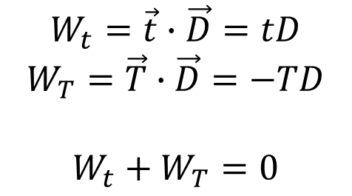
Tension in coupled objects
Net work done by tension in coupled system is zero
$$W_{t}=\vec{t}∙\vec{D}=tD$$
$$W_{T}=\vec{T}∙\vec{D}=−TD$$
$$W_{t}+W_{T}=0$$

Slide 17
Example with coupled objects
A block of mass m is on a frictionless incline that makes an angle θ with the vertical. A light string attaches it to another block of mass M that hangs over a massless frictionless pulley. The blocks are then released from rest, and the block of mass M descends. What is the blocks’ speed after they move a distance D?

