Slide 1
Lecture 13:
Static Fluids
Pressure
Pascal’s Principle
Buoyancy force

Slide 2
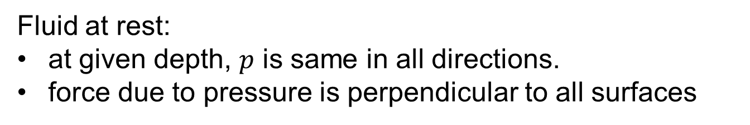
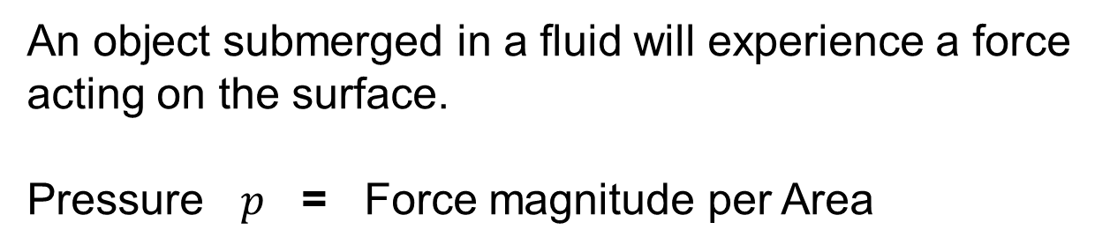
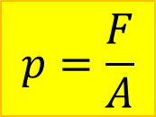
Pressure
An object submerged in a fluid will experience a force acting on the surface.
Pressure $p$ = Force magnitude per Area
$$p=\frac{F}{A}$$
Unit: N/m² = Pa
Fluid at rest:
at given depth, $p$ is same in all directions.
force due to pressure is perpendicular to all surfaces

Slide 3
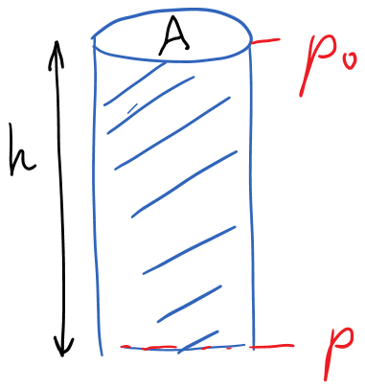
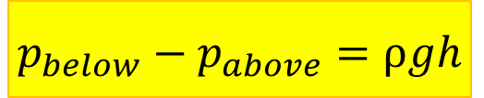
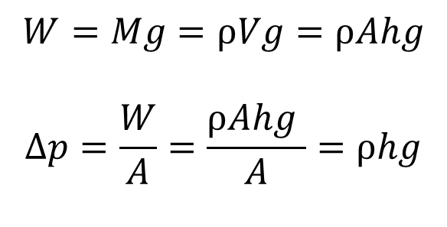
Pressure increase with depth
Due to weight of column of fluid above
$$W=Mg=ρVg=ρAhg$$
$$∆p=\frac{W}{A}=\frac{ρAhg }{A}=ρhg$$
$$p_{below}−p_{above}=ρgh$$

Slide 4
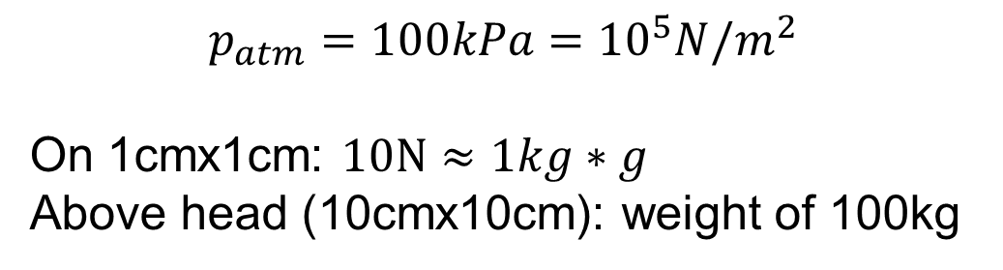
Atmospheric pressure
$$p_{atm}=100kPa={10}^{5}N/m^{2}$$
On 1cmx1cm: $10N≈1kg∗g$
Above head (10cmx10cm): weight of 100kg
Demo: Magdeburg hemispheres

Slide 5
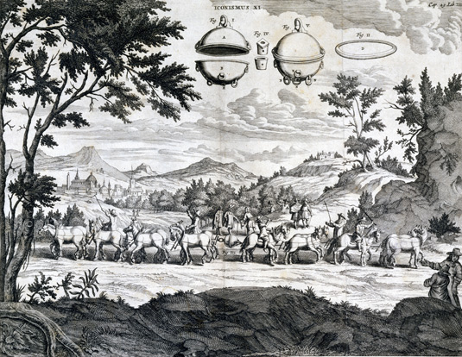
Magdeburg hemispheres
Otto von Guericke, 1654. 30 horses.

Slide 6
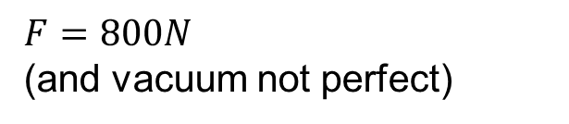


Magdeburg Hemispheres: estimate
D=50cm
$$p=\frac{F}{A}$$
$$F=pA=2x{10}^{4}N$$
Classroom demo: D=10cm
$F=800N$ (and vacuum not perfect)

Slide 7
Pascal’s Principle
Pressure applied to a confined fluid increases the pressure throughout the fluid by the same amount.
All points at the same level in a contiguous fluid have the same pressure.

Slide 8
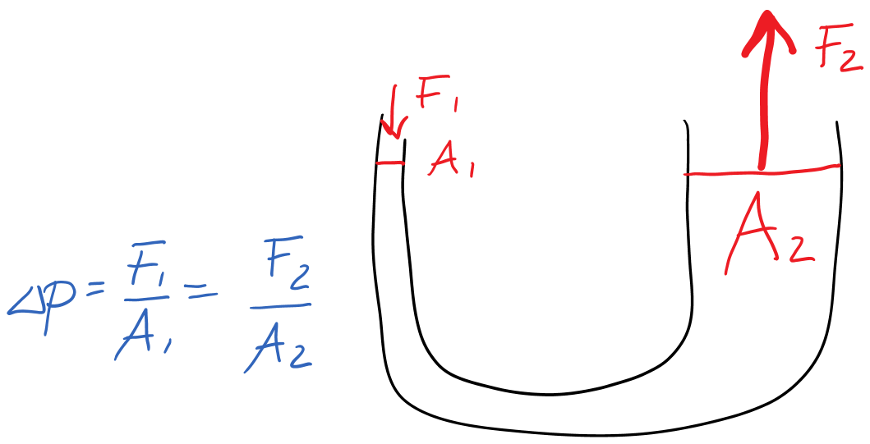
Application of Pascal’s Principle: Hydraulic Lift

Slide 9
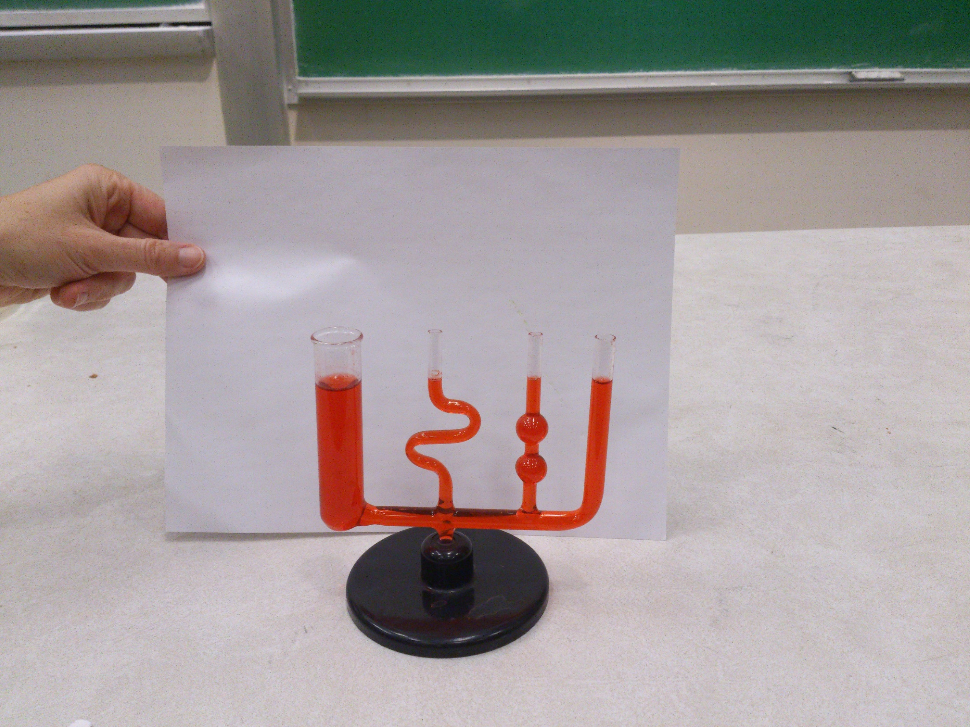
Demo: same water level in connected tubes of different shapes and cross sections

Slide 10
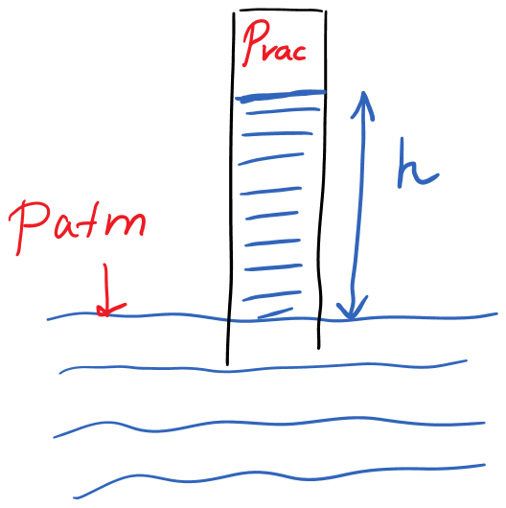
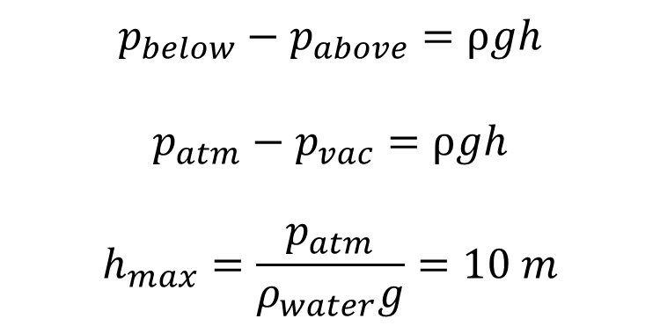
The longest straw… or: How high can you pump water by suction?
$$p_{below}−p_{above}=ρgh$$
$$p_{atm}−p_{vac}=ρgh$$
$$h_{max}=\frac{p_{atm}}{ρ_{water}g}=10 m$$

Slide 11
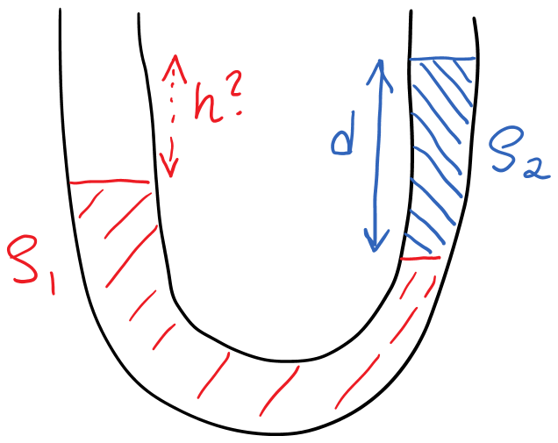
Example 1

Slide 12
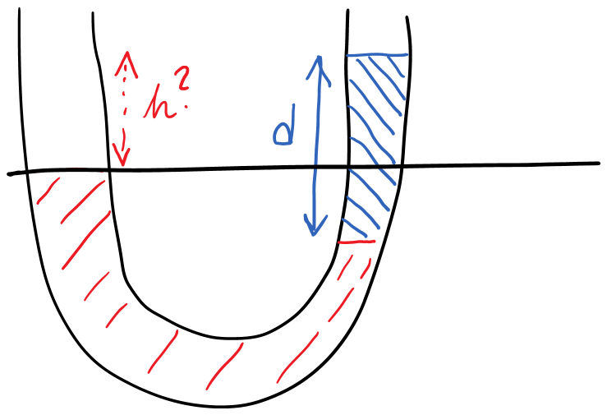
At this level, Pascal’s Principle does not apply

Slide 13
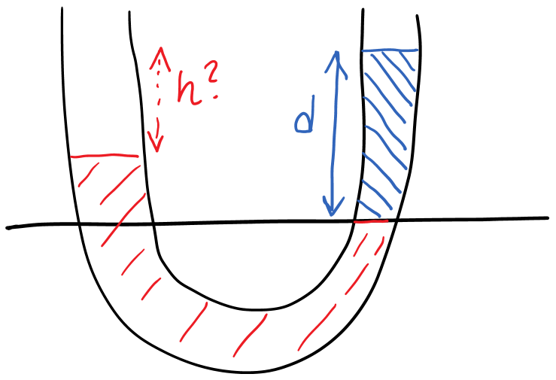
Example 1: slide 2
At this level, Pascal’s Principle applies (continuous fluid)

Slide 14
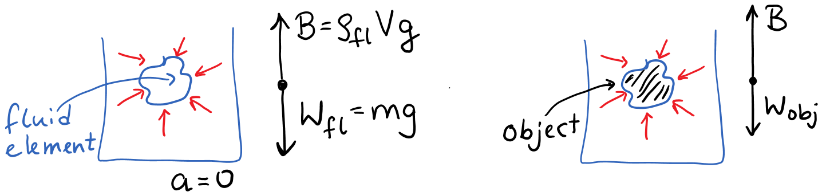

Buoyancy and Archimedes’ Principle
An object fully or partially submerged in a fluid experiences an upward buoyancy force equal to the weight magnitude of the fluid displaced by the object.
$$B=ρ_{fluid}V_{disp}g$$

Slide 15
Consequences of Archimedes’ Principle
Density of object less than density of fluid:
Object floats
Density of object larger than density of fluid:
Object sinks
Demo: Buoyancy force

Slide 16
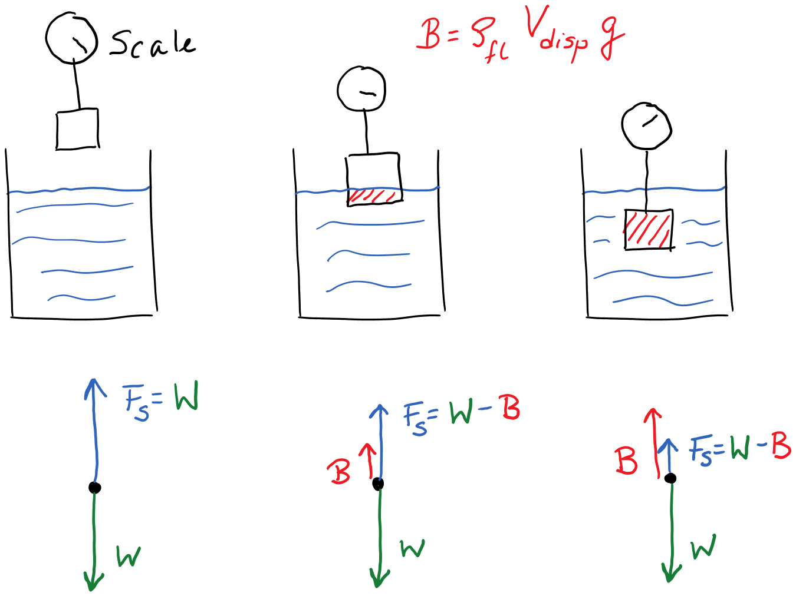
Demo for buoyancy

Slide 17
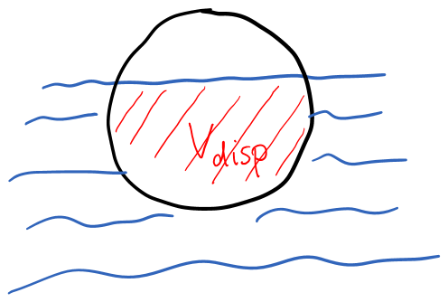
Example 2
A ball has a uniform mass density of ⅓ the density of water. What fraction of the ball’s volume is below the water line?

Slide 18
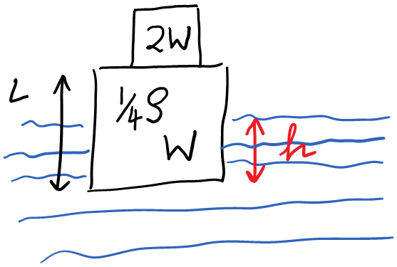
Example 3
A cube of side length L is placed in water and an object with twice the cube’s weight is placed on top of it. Because the density of water is ρ and the cube has a uniform density of ¼ρ, a portion of the cube remains above the waterline. If the cube stays in a level orientation, what is the difference between the pressure at the cube’s lower (submerged) surface and atmospheric pressure, i.e., what is the gauge pressure at the lower surface?

