Slide 1
Lecture 14:
Fluid Dynamics
Continuity
Bernoulli’s Equation
Viscosity

Slide 2





Ideal Fluid
Steady (laminar) flow
Incompressible
Non-viscous
laminar
turbulent

Slide 3
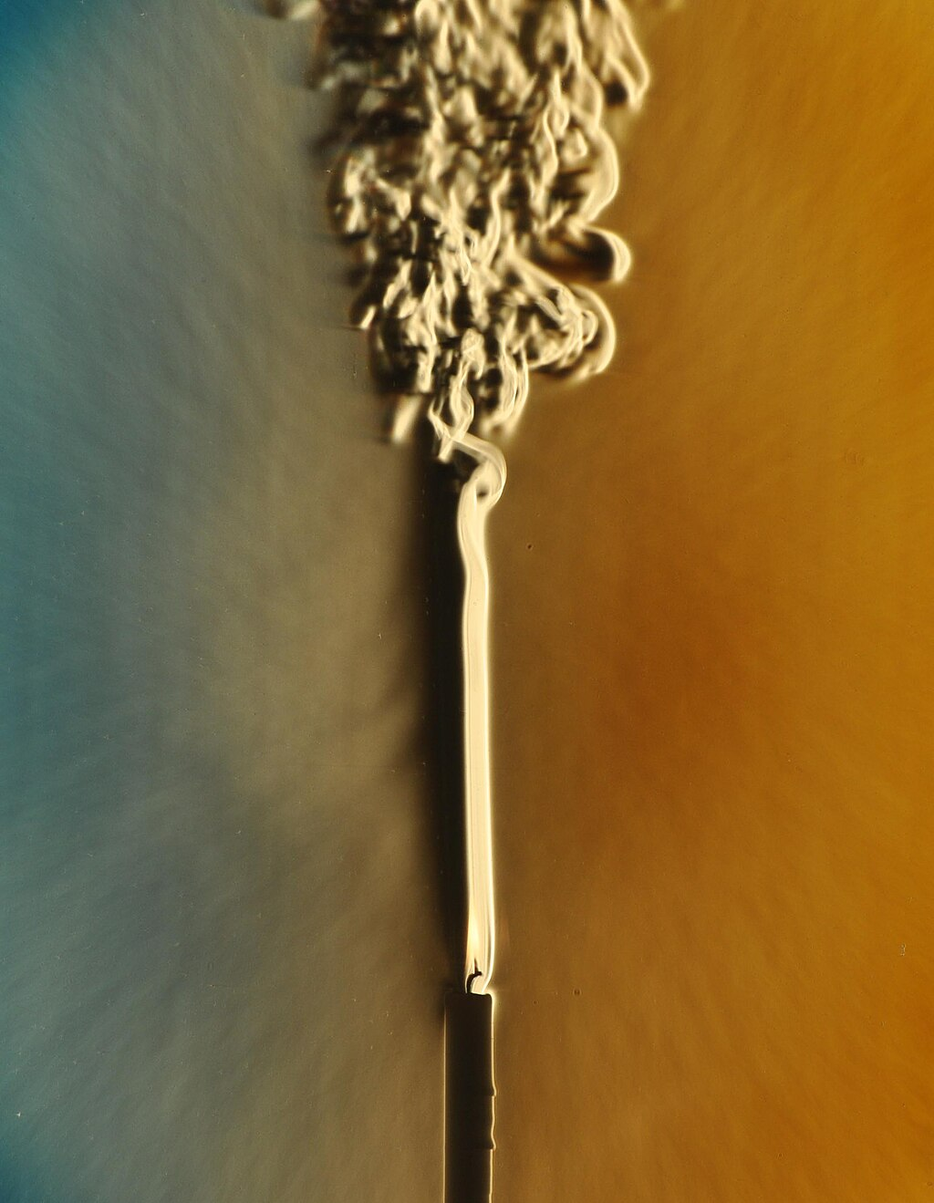
Laminar to turbulent transition
Thermal convection plume rising from a candle in still air. The plume is initially laminar, but transition to turbulence occurs in the upper 1/3 of the image.
Credit: Dr. Gary Settles

Slide 4
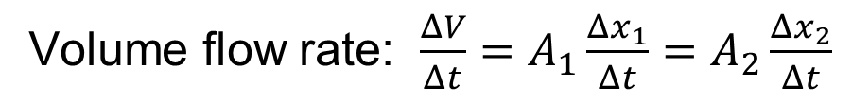




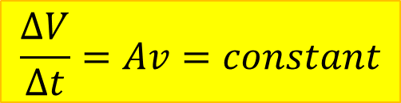
Continuity
“What goes in must come out”
$${Δx}_{1}$$
$${Δx}_{2}$$
$$A_{1}$$
$$A_{2}$$
Volume flow rate: $\frac{ΔV}{Δt}=A_{1}\frac{Δx_{1}}{Δt}=A_{2}\frac{Δx_{2}}{Δt}$
$$\frac{ΔV}{Δt}=Av=constant$$

Slide 5





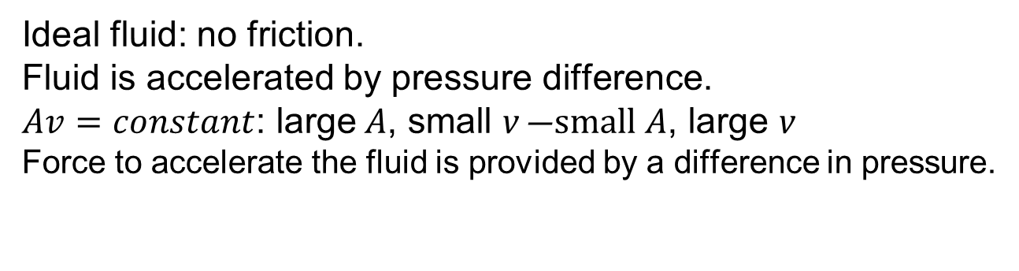

Bernoulli’s Principle
Ideal fluid: no friction.
Fluid is accelerated by pressure difference.
$Av=constant$: large A, small v ―small A, large v
Force to accelerate the fluid is provided by a difference in pressure.
$$v_{1}$$
$$v_{2}$$
$$a$$
$$p_{1}$$
$$>$$
$$p_{2}$$
As fluid speed increases, pressure decreases.

Slide 6








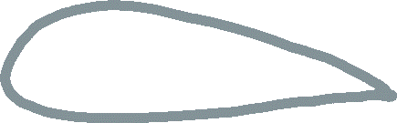



Airplane wing
Higher speed,
lower pressure
lower speed,
higher pressure
Lift

Slide 7
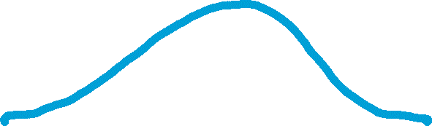



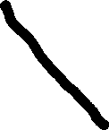



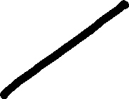


High wind lifts roof off house
Higher speed,
lower pressure
Atmospheric
pressure

Slide 8






Applications for Bernoulli’s Principle
As fluid speed increases, pressure decreases.
$$v_{1}$$
$$v_{2}$$
$$a$$
$$p_{1}$$
$$>$$
$$p_{2}$$
✈️ Air over airplane wing → Lift
🧪 Venturi tube (narrow pipe section) → Pressure drop
🌬️ Wind over a roof → Suction effect
🌫️ Pump spray → Suction draws fluid upward

Slide 9
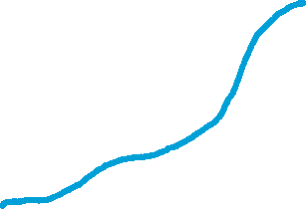
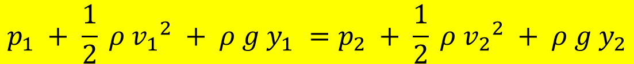


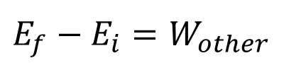
Bernoulli’s Equation
Application of energy conservation:
$E_{f}−E_{i}=W_{other}$
$$½m{v_{f}}^{2}+mgy_{f}−½m{v_{i}}^{2}−mgy_{i}=F_{1}d_{1}−F_{2}d_{2}$$
$½m{v_{2}}^{2}+mgy_{2}−½m{v_{1}}^{2}−mgy_{1}=p_{1}A_{1}d_{1}−$ $p_{2}A_{2}d_{2}=p_{1}V−p_{2}V$
$$p_{1} + \frac{1}{2} ρ {v_{1}}^{2} + ρ g y_{1} =p_{2} + \frac{1}{2} ρ {v_{2}}^{2} + ρ g y_{2}$$

Slide 10
Example: Water Tank with Hole

Slide 11
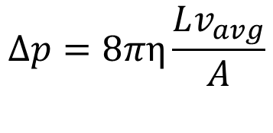




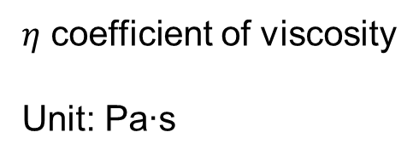
Viscous fluids
Resistance to flow: A viscous fluid needs a pressure difference between the ends of a tube to keep the fluid moving at constant speed.
Compare: Moving a block at constant speed along rough surface requires a force.
$$L$$
$$Δp=8πη\frac{Lv_{avg}}{A}$$
$$v_{avg}$$
$η$ coefficient of viscosity
Unit: Pa∙s
$$p+∆p$$
$$p$$

Slide 12
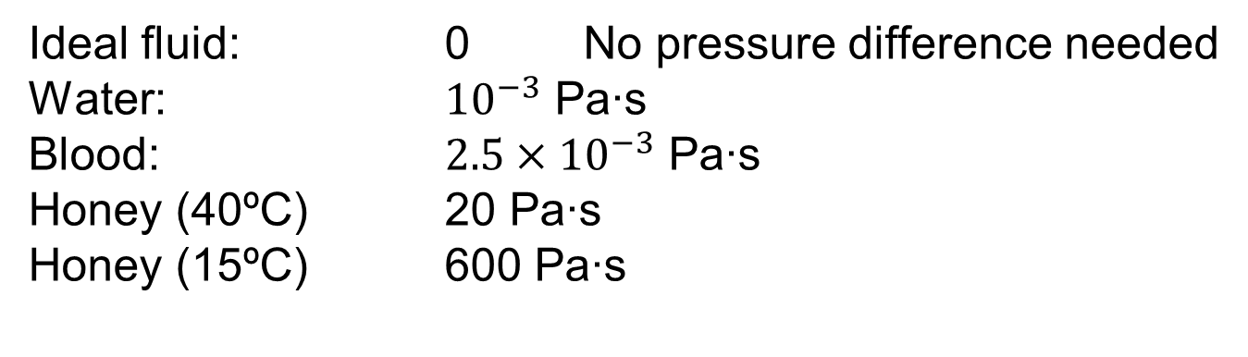
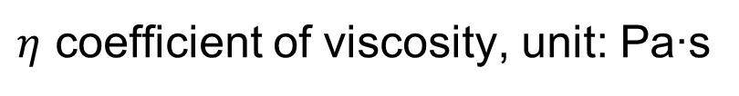
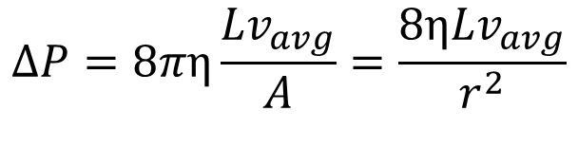
Viscosity
$$ΔP=8πη\frac{Lv_{avg}}{A}=\frac{8ηLv_{avg}}{r^{2}}$$
$η$ coefficient of viscosity, unit: Pa∙s
Ideal fluid: 0 No pressure difference needed
Water: ${10}^{−3}$ Pa∙s
Blood: $2.5×{10}^{−3}$ Pa∙s
Honey (40ºC) 20 Pa∙s
Honey (15ºC) 600 Pa∙s

Slide 13
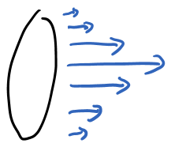
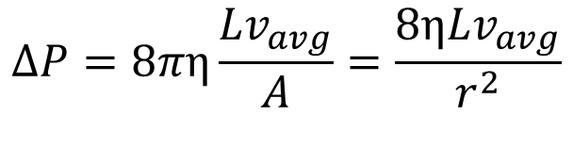
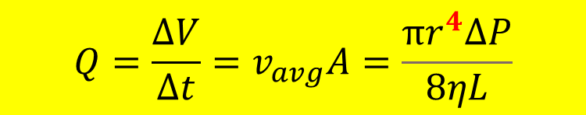
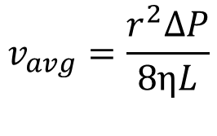
Poiseuille’s Equation
Viscous fluid: speed changes over cross section of tube, fastest in the center, outermost layer does not move at all
$$ΔP=8πη\frac{Lv_{avg}}{A}=\frac{8ηLv_{avg}}{r^{2}}$$
$$v_{avg}=\frac{r^{2}ΔP}{8ηL}$$
$$Q=\frac{∆V}{∆t}=v_{avg}A=\frac{πr^{4}ΔP}{8ηL}$$

Slide 14

Applications of Poiseuille’s Equation
$$Q=\frac{∆V}{∆t}=v_{avg}A=\frac{πr^{4}ΔP}{8ηL}$$
Blood Flow in Capillaries and Arteries
• Vessel radius strongly affects flow rate
• Basis for understanding blood pressure and vascular resistance
IV Drips and Catheters
• Predicts flow rate in tubing used for fluid delivery
Respiratory Physiology
• Airflow through small bronchioles: small reductions in airway radius drastically reduce flow (asthma, obstructive lung diseases)
Microfluids in chip design, inkjet printing, lubrication systems

