Slide 1
Lecture 15: Universal gravitation
Kepler’s Laws of planetary motion
Newton’s law of universal gravitation
Free fall acceleration on surface of a planet
Satellite motion

Slide 2
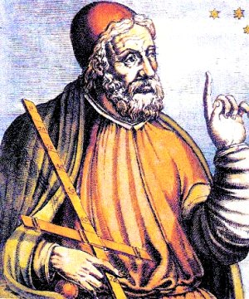
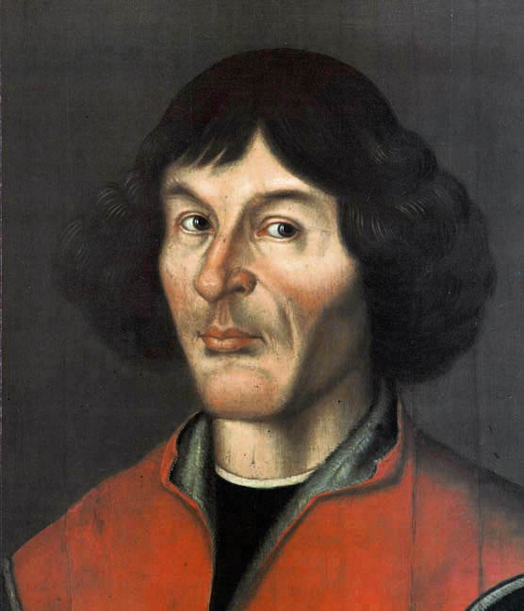
Brief history of cosmology
Nicolaus Copernikus
(1473-1543)
heliocentric theory
Ptolemy (85 - 165)
geocentric theory

Slide 3
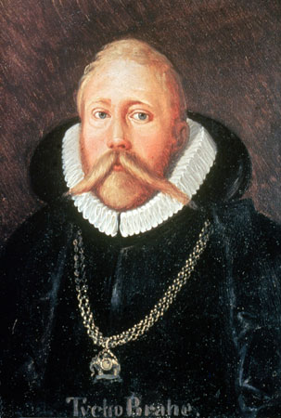
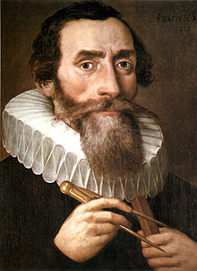
History continued
Johannes Kepler
(1571-1630)
Laws of planetary motion
Tycho Brahe
(1546-1601)

Slide 4
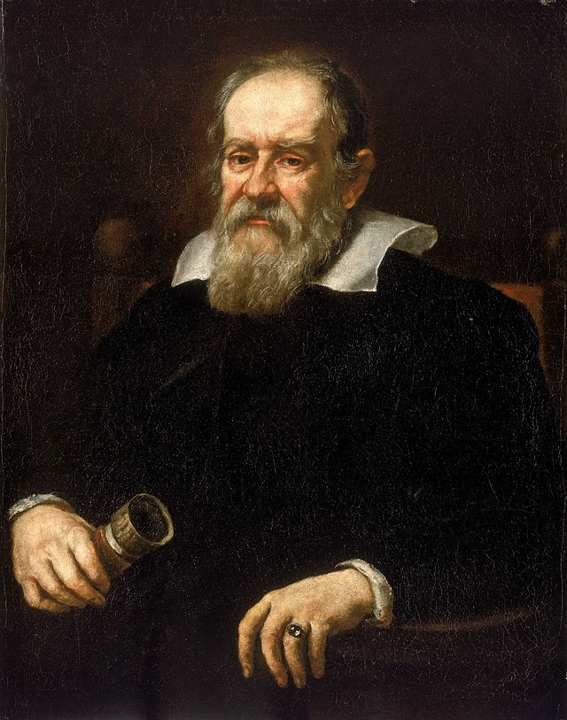
Galileo Galilei (1564 - 1642)
telescope
discovered moons orbiting Jupiter observed phases of Venus

Slide 5

Kepler’s Laws: 1st Law
The planets move in elliptical orbits with the sun at one focus of the ellipse.
Kepler's First Law simulation

Slide 6
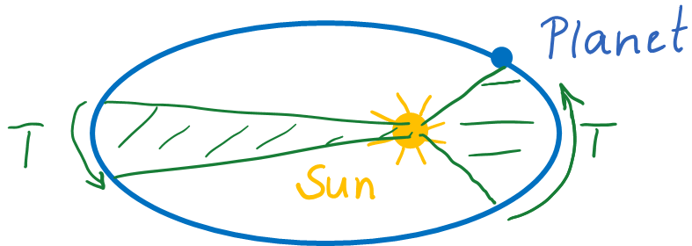
Kepler’s 2nd Law
A line drawn between the sun and a planet sweeps out equal areas in equal intervals of time
Keple's 2nd Law simulation

Slide 7
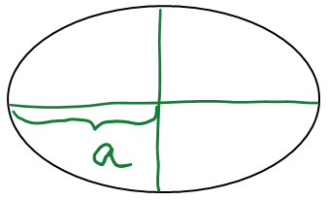
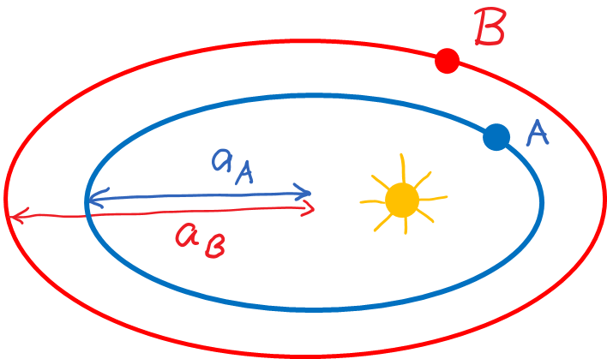
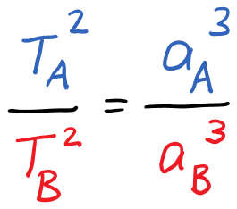

Kepler’s 3rd law
The square of a planet’s orbital period is proportional to the cube of the semi-major axis length.
$$T^{2}∼a^{3}$$

Slide 8
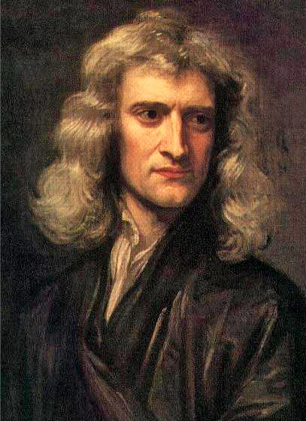
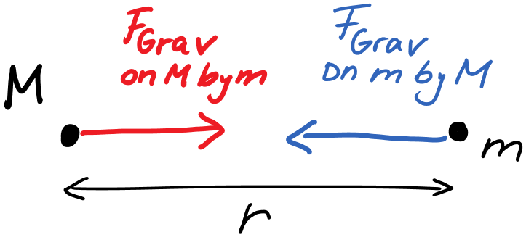
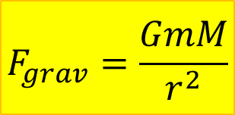
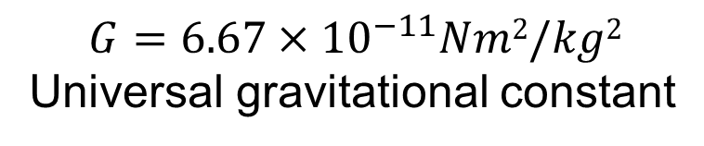
Newton’s Law of Universal Gravitation
$$F_{grav}=\frac{GmM}{r^{2}}$$
Sir Isaac Newton (1643 - 1727)
$$G=6.67×{10}^{−11}Nm2/kg2$$
Universal gravitational constant

Slide 9
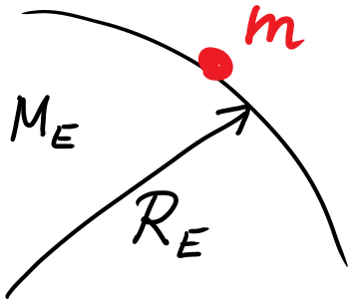
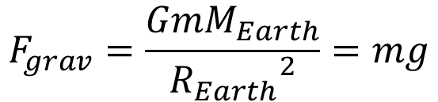
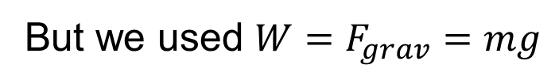
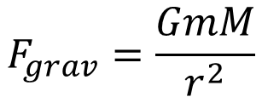
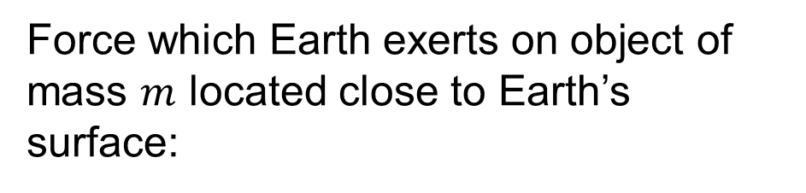
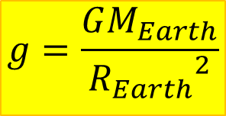
Gravitation near Earth’s surface
$$F_{grav}=\frac{GmM}{r^{2}}$$
But we used ${W=F}_{grav}=mg$
Force which Earth exerts on object of mass $m$ located close to Earth’s surface:
$$F_{grav}=\frac{GmM_{Earth}}{{R_{Earth}}^{2}}=mg$$
$$g=\frac{GM_{Earth}}{{R_{Earth}}^{2}}$$
⟶ Find free-fall acceleration on any planet of mass M and radius R

Slide 10
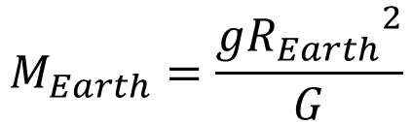
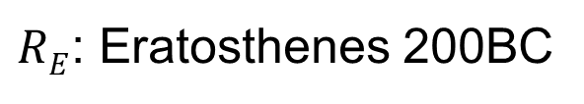
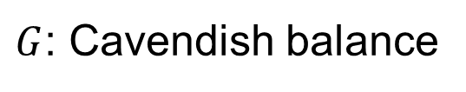
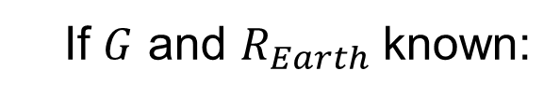
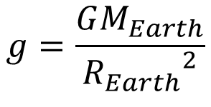
Find mass of Earth
$$g=\frac{GM_{Earth}}{{R_{Earth}}^{2}}$$
If $G$ and $R_{Earth}$ known:
$$M_{Earth}=\frac{g{R_{Earth}}^{2}}{G}$$
$G$: Cavendish balance
$RE$: Eratosthenes 200BC

Slide 11
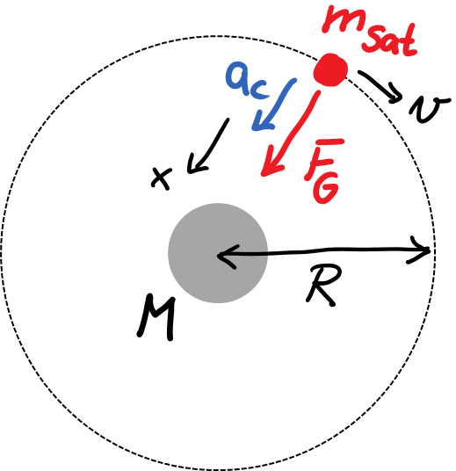
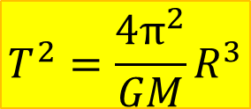
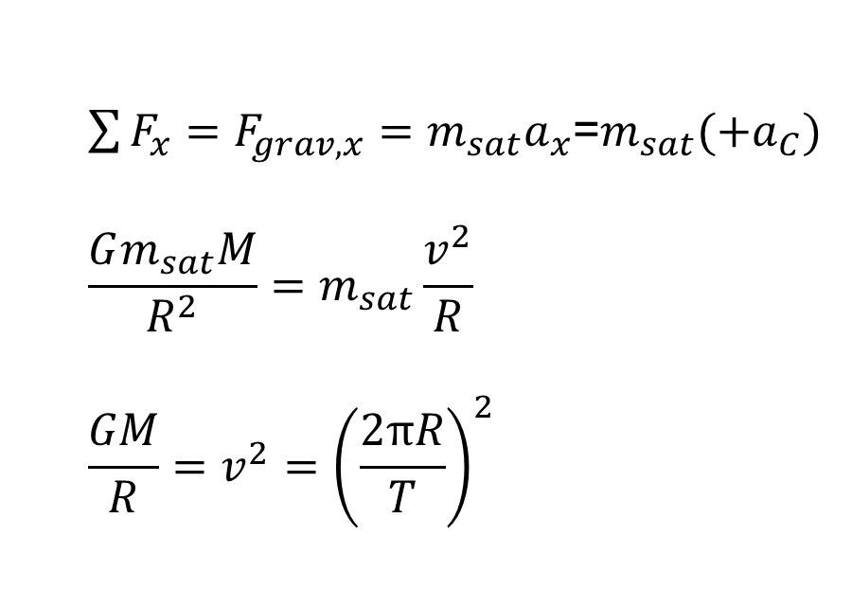
Satellite Motion
$\sum{F_{x}}=F_{grav,x}=m_{sat}a_{x}$=$m_{sat}(+a_{C})$
$$\frac{Gm_{sat}M}{R^{2}}=m_{sat}\frac{v^{2}}{R}$$
$$\frac{GM}{R}=v^{2}={\left(\frac{2πR}{T}\right)}^{2}$$
$$T^{2}=\frac{4π^{2}}{GM}R^{3}$$
Kepler’s 3rd Law

Slide 12
Example 2
A satellite of mass m is orbiting with period T in a circular orbit a distance h above the surface of a planet. The radius of the planet is R. Find the free-fall acceleration on the planet’s surface.

