Slide 1
Lecture 16: Gravitational potential energy and space travel
Universal gravitational potential energy
Space travel problems
Escape speed
Orbital energy
Multiple objects

Slide 2
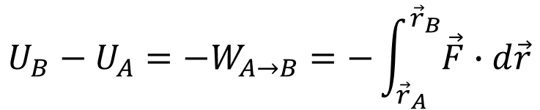
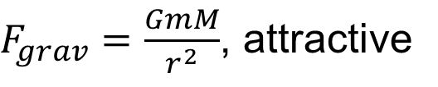
Gravitational potential energy
$F_{grav}=\frac{GmM}{r^{2}}$, attractive
Conservative force
$$U_{B}−U_{A}=−W_{A→B}=−\int_{{\vec{r}}_{A}}^{{\vec{r}}_{B}}{\vec{F}∙d\vec{r}}$$

Slide 3

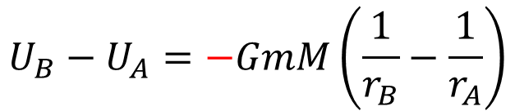
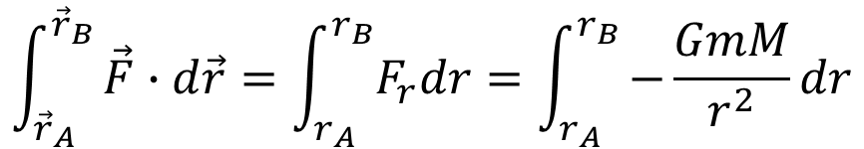
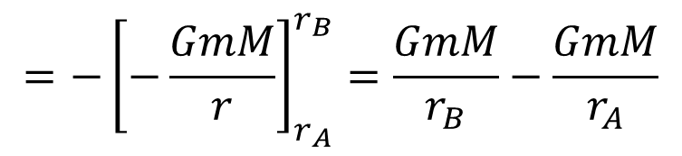
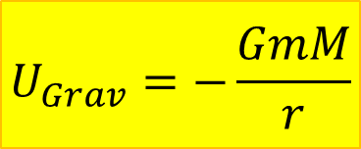
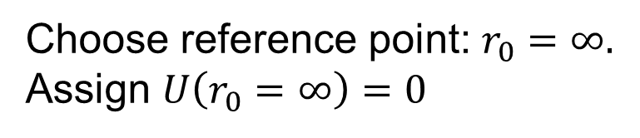
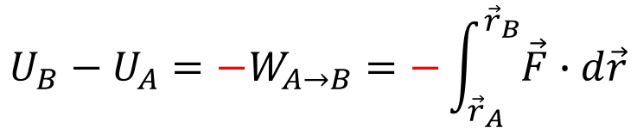
$$U_{B}−U_{A}=−W_{A→B}=−\int_{{\vec{r}}_{A}}^{{\vec{r}}_{B}}{\vec{F}∙d\vec{r}}$$
$$\int_{{\vec{r}}_{A}}^{{\vec{r}}_{B}}{\vec{F}∙d\vec{r}=\int_{r_{A}}^{r_{B}}{F_{r}dr}=\int_{r_{A}}^{r_{B}}{−\frac{GmM}{r^{2}}}dr}$$
$$=−{\left[−\frac{GmM}{r}\right]}_{r_{A}}^{r_{B}}=\frac{GmM}{r_{B}}−\frac{GmM}{r_{A}}$$
$$U_{B}−U_{A}=−GmM\left(\frac{1}{r_{B}}−\frac{1}{r_{A}}\right)$$
$$U_{Grav}=−\frac{GmM}{r}$$
Choose reference point: $r_{0}=∞.$
Assign $U\left(r_{0}=∞\right)=0$
negative!

Slide 4

Potential energy diagram
$$U\left(r_{0}=∞\right)=0$$

Slide 5
Potential energy diagram

Slide 6

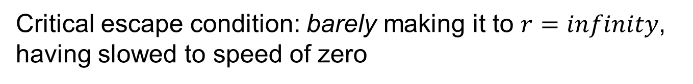
Escape condition
$$E=½mv^{2}−\frac{GmM}{r}$$
Critical escape condition: barely making it to $r=infinity$, having slowed to speed of zero

Slide 7
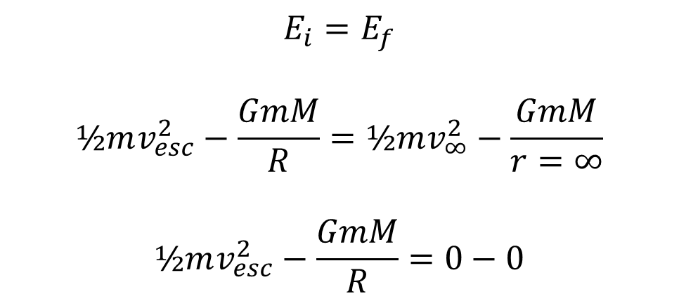
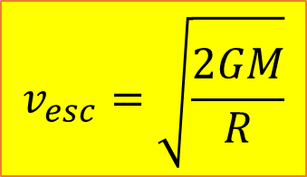
Escape speed
Minimum speed an object must have at distance R from central mass M if it is to go infinitely far away
$$E_{i}=E_{f}$$
$$½mv_{esc}^{2}−\frac{GmM}{R}=½mv_{∞}^{2}−\frac{GmM}{r=∞}$$
$$½mv_{esc}^{2}−\frac{GmM}{R}=0−0$$
$$v_{esc}=\sqrt{\frac{2GM}{R}}$$

Slide 8

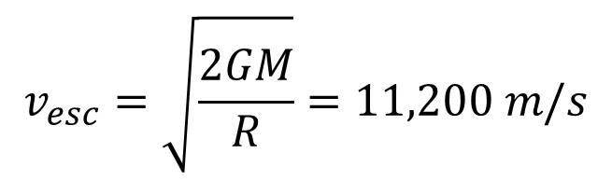
Example: Escape speed from Earth
$$MEarth=5.97 × {10}^{24}kg$$
$$REarth= 6.38 × {10}^{6} m$$
$$G=6.67 × {10}^{−11} N m2/kg2$$
$$v_{esc}=\sqrt{\frac{2GM}{R}}=11,200 m/s$$

Slide 9
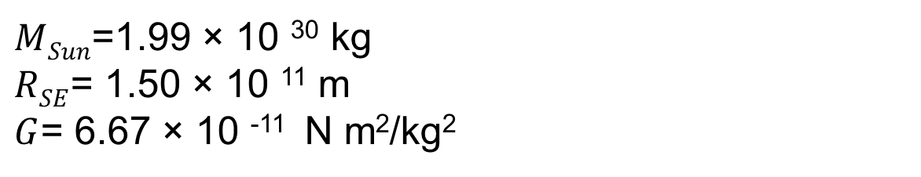
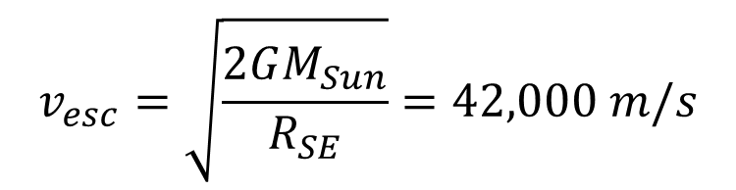
Example: Escape speed from orbit
Speed necessary to escape gravitational field of the Sun when object is launched from Earth:
$MSun$=1.99 × 10 ³⁰ kg
$RSE$= 1.50 × 10 ¹¹ m
$G$= 6.67 × 10 ⁻¹¹ N m²/kg²
$$v_{esc}=\sqrt{\frac{2GM_{Sun}}{R_{SE}}}=42,000 m/s$$

Slide 10
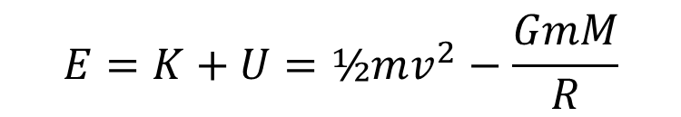
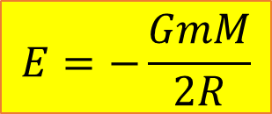
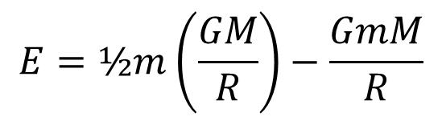
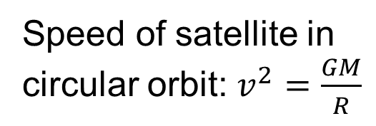
Orbital Energy
$$E=K+U=½mv^{2}−\frac{GmM}{R}$$
Speed of satellite in
circular orbit: $v^{2}=\frac{GM}{R}$
$$E=½m\left(\frac{GM}{R}\right)−\frac{GmM}{R}$$
$$E=−\frac{GmM}{2R}$$

Slide 11
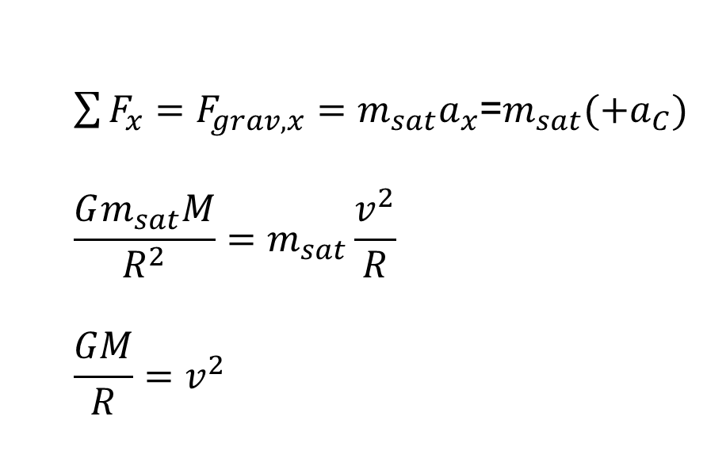
Satellite Motion
$\sum{F_{x}}=F_{grav,x}=m_{sat}a_{x}$=$m_{sat}(+a_{C})$
$$\frac{Gm_{sat}M}{R^{2}}=m_{sat}\frac{v^{2}}{R}$$
$$\frac{GM}{R}=v^{2}$$

Slide 12
Multiple objects

Slide 13
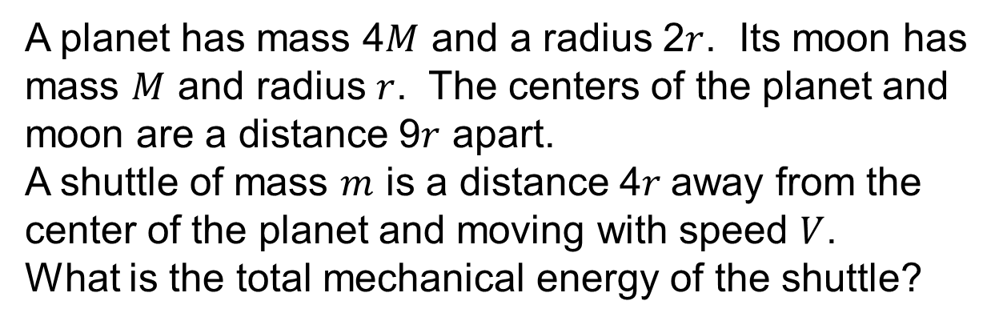
Example with multiple objects
A planet has mass 4$M$ and a radius 2$r$. Its moon has mass $M$ and radius $r$. The centers of the planet and moon are a distance 9$r$ apart.
A shuttle of mass $m$ is a distance 4$r$away from the center of the planet and moving with speed $V$.
What is the total mechanical energy of the shuttle?

Slide 14
If the shuttle was initially at rest at X, how much work did the engines do?

