Slide 1
Lecture 17: Linear momentum
Define impulse and linear momentum
Systems of particles
Conservation of linear momentum
Explosions and collisions
Cats playing with Newton's cradle

Slide 2
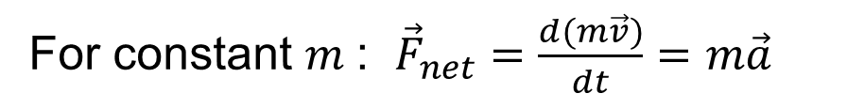

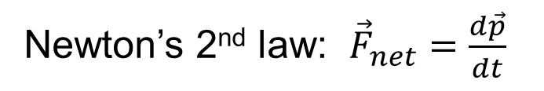
Linear Momentum
$$\vec{p}=m\vec{v}$$
Vector!
Newton’s 2nd law: ${\vec{F}}_{net}=\frac{d\vec{p}}{dt}$
For constant $m$ : ${\vec{F}}_{net}=\frac{d(m\vec{v})}{dt}=m\vec{a}$

Slide 3
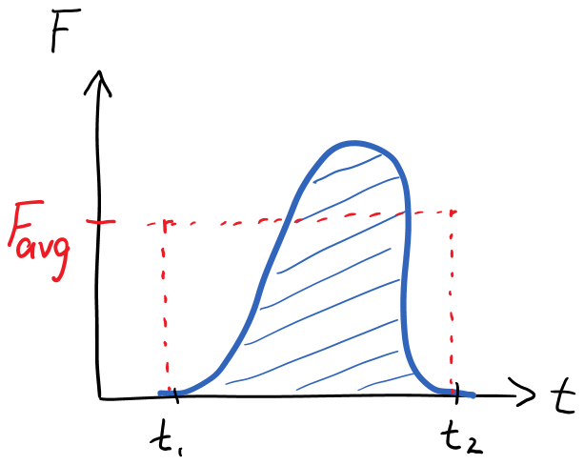

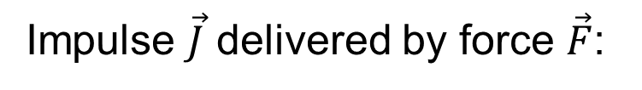
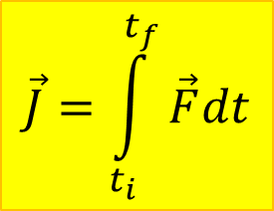
Impulse
Impulse $\vec{J}$ delivered by force $\vec{F}$:
$$\vec{J}=\int_{t_{i}}^{t_{f}}{\vec{F}dt}$$
Vector!
$$\vec{J}={\vec{F}}_{avg}∆t$$

Slide 4


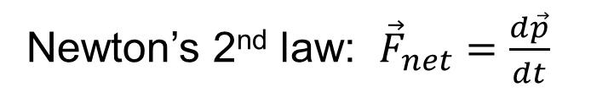
Change in momentum and impulse
Newton’s 2nd law: ${\vec{F}}_{net}=\frac{d\vec{p}}{dt}$
Integrate:
$$\int_{t_{i}}^{t_{f}}{{\vec{F}}_{net}dt=\int_{t_{i}}^{t_{f}}{\frac{d\vec{p}}{dt}dt}}$$
$${\vec{J}}_{net}={\vec{p}}_{f}−{\vec{p}}_{i}=Δ\vec{p}$$

Slide 5
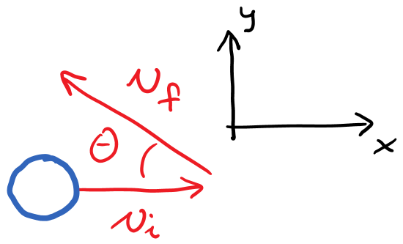
Example: kicking a ball
A soccer ball of mass m is moving with speed $vi$ in the positive x-direction. After being kicked by the player’s foot, it moves with speed $vf$ at an angle θ with respect to the negative x-axis.
Calculate the impulse delivered to the ball by the player.

Slide 6
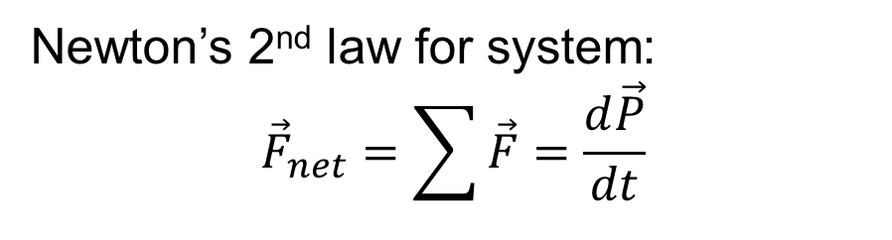
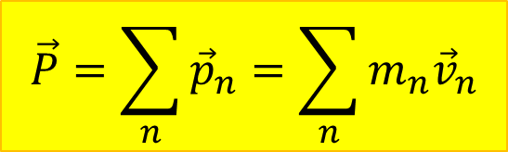
System of particles
$$\vec{P}=\sum_{n}{{\vec{p}}_{n}}=\sum_{n}{m_{n}{\vec{v}}_{n}}$$
Linear momentum
vector of system
Newton’s 2nd law for system:
$${\vec{F}}_{net}=\sum{\vec{F}}=\frac{d\vec{P}}{dt}$$

Slide 7
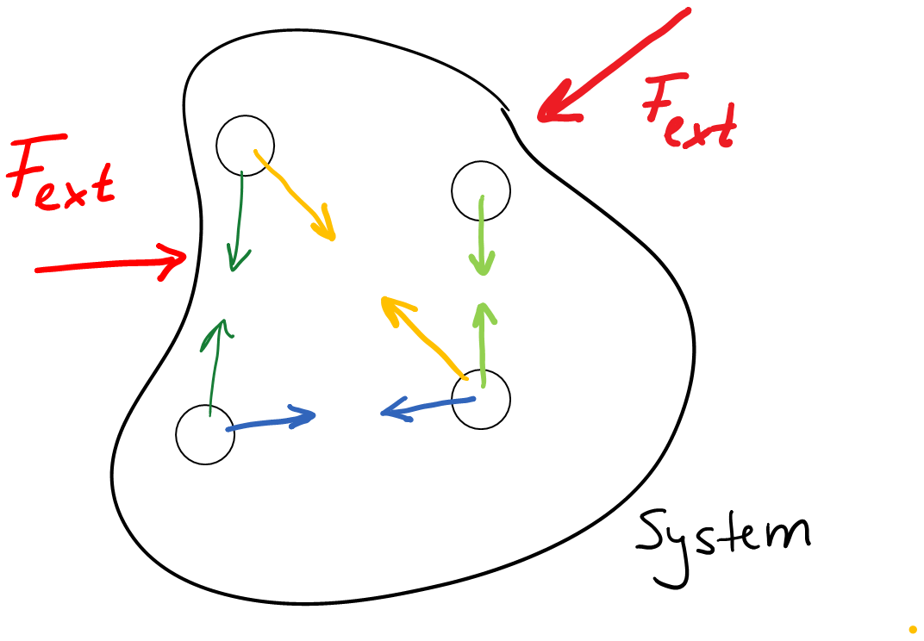
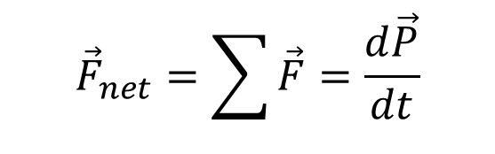

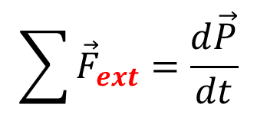
System of particles
$${\vec{F}}_{net}=\sum{\vec{F}}=\frac{d\vec{P}}{dt}$$
Internal forces occur in
action-reaction pairs,
cancel.
Only external forces remain
$$\sum{{\vec{F}}_{ext}}=\frac{d\vec{P}}{dt}$$
$${\vec{J}}_{net ext}={\vec{P}}_{f}−{\vec{P}}_{i}=Δ\vec{P}$$

Slide 8

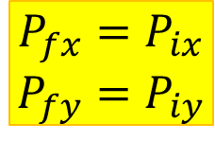
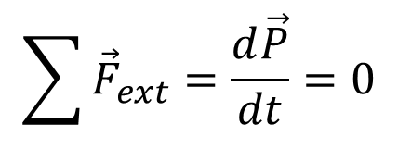
Conservation of linear momentum
If no external forces act:
$$\sum{{\vec{F}}_{ext}}=\frac{d\vec{P}}{dt}=0$$
$$P_{fx}=P_{ix}$$
$$P_{fy}=P_{iy}$$
$${\vec{P}}_{f}={\vec{P}}_{i}$$
Example: explosions

Slide 9
Example: Explosion
A firecracker of mass M is traveling with speed V in the positive x-direction. It explodes into two fragments of equal mass. Fragment A moves away at an angle θ above the positive x-axis, as shown in the figure. Fragment B moves along the negative y-axis
Find the speeds
of the fragments.

Slide 10
Recipe for Momentum Problems
Draw before and after sketch
Label masses and draw momentum/velocity vectors
Draw vector components
Starting equation.
Conservation of momentum if appropriate
Sum initial and final momenta
Express components
Solve symbolically

Slide 11
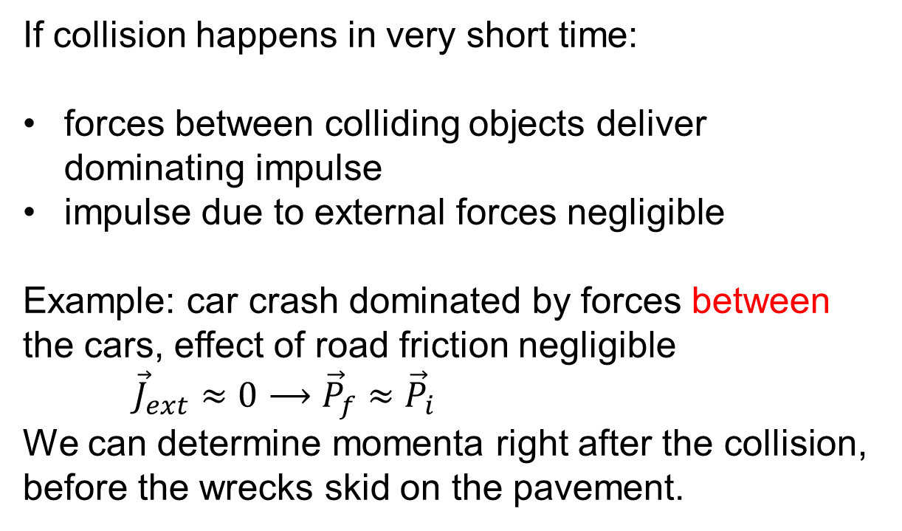

Short collisions
If collision happens in very short time:
forces between colliding objects deliver dominating impulse
impulse due to external forces negligible
Example: car crash dominated by forces between the cars, effect of road friction negligible
${\vec{J}}_{ext}≈0⟶{\vec{P}}_{f}≈{\vec{P}}_{i}$
We can determine momenta right after the collision, before the wrecks skid on the pavement.
$$\vec{J}=\int_{t_{i}}^{t_{f}}{\vec{F}dt}$$

Slide 12
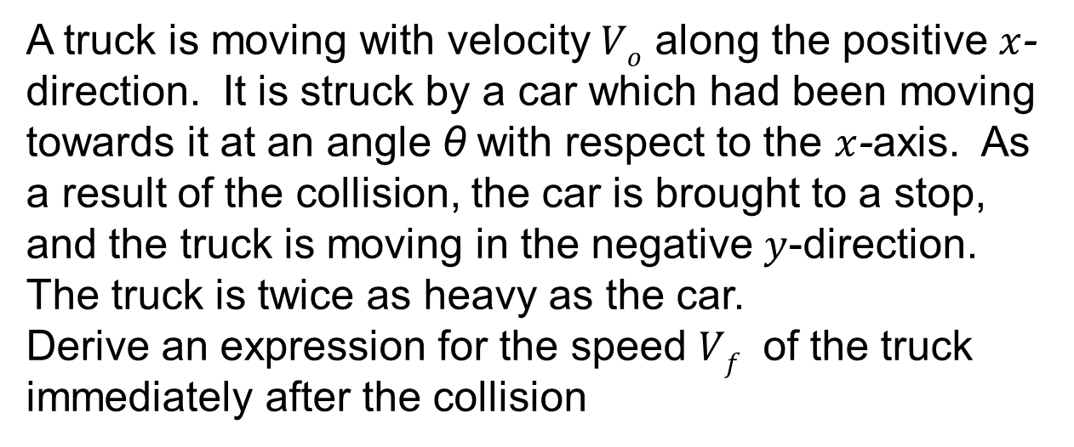
Example: Collision
A truck is moving with velocity $Vo$ along the positive $x$-direction. It is struck by a car which had been moving towards it at an angle θ with respect to the $x$-axis. As a result of the collision, the car is brought to a stop, and the truck is moving in the negative $y$-direction. The truck is twice as heavy as the car.
Derive an expression for the speed $Vf$ of the truck immediately after the collision

Slide 13
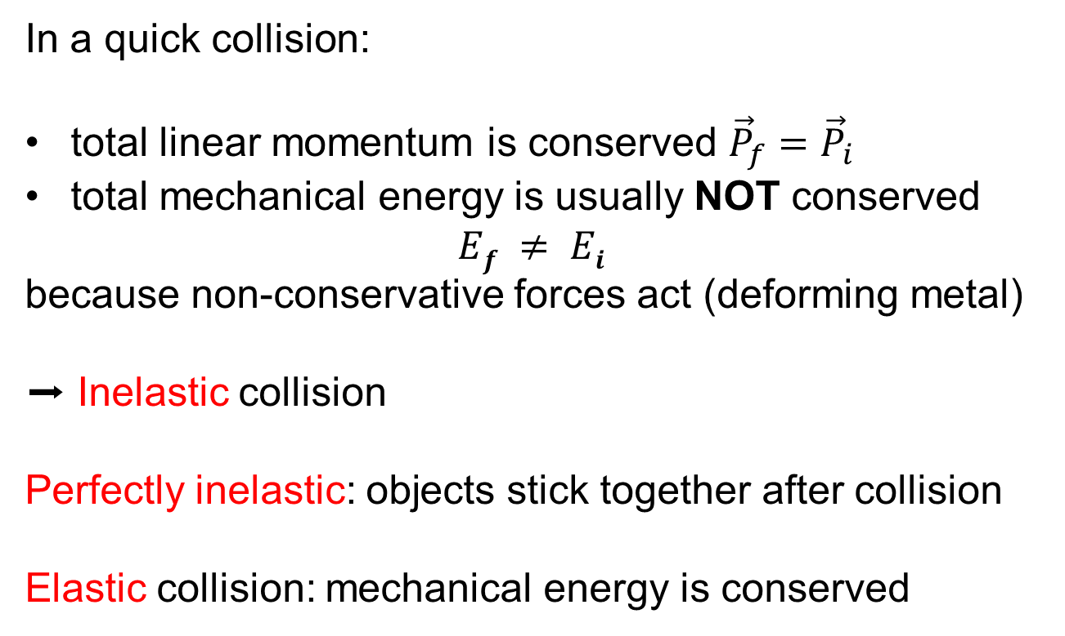
Energy in collisions
In a quick collision:
total linear momentum is conserved ${\vec{P}}_{f}={\vec{P}}_{i}$
total mechanical energy is usually NOT conserved
$$Ef ≠ Ei$$
because non-conservative forces act (deforming metal)
➡ Inelastic collision
Perfectly inelastic: objects stick together after collision
Elastic collision: mechanical energy is conserved
Demo: Elastic and inelastic 1-D collisions on air track

Slide 14
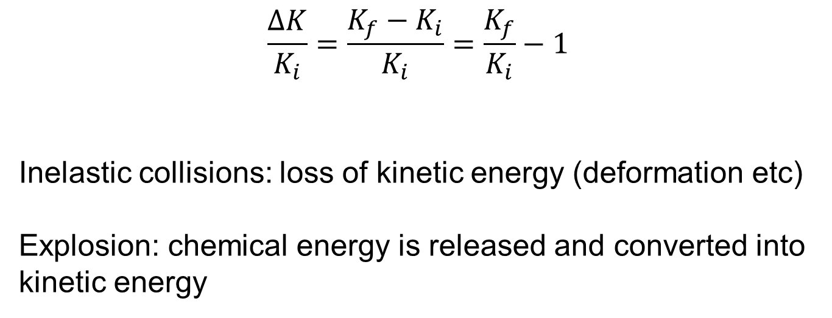
Fractional change of kinetic energy
$$\frac{∆K}{K_{i}}=\frac{K_{f}−K_{i}}{K_{i}}=\frac{K_{f}}{K_{i}}−1$$
Inelastic collisions: loss of kinetic energy (deformation etc)
Explosion: chemical energy is released and converted into kinetic energy

