Slide 1
Lecture 18:
Linear momentum and energy.
Center of mass motion.
Multi-step problems
Elastic Collisions
Center of mass motion
Rocket propulsion

Slide 2
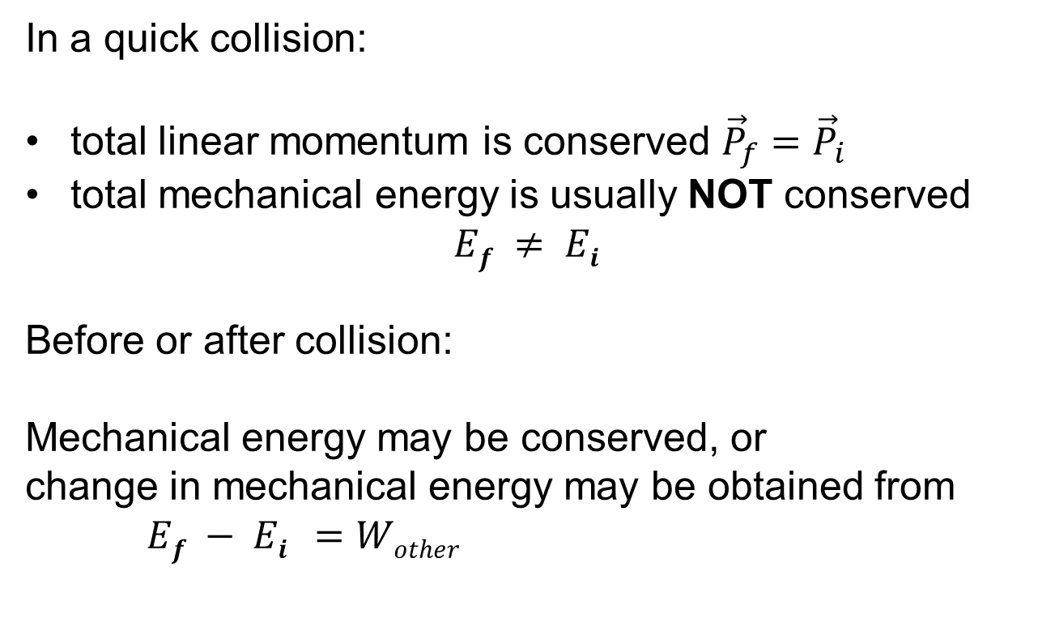
Momentum and energy in multi-step problems
In a quick collision:
total linear momentum is conserved ${\vec{P}}_{f}={\vec{P}}_{i}$
total mechanical energy is usually NOT conserved
$$Ef ≠ Ei$$
Before or after collision:
Mechanical energy may be conserved, or
change in mechanical energy may be obtained from
$Ef − Ei =Wother$

Slide 3
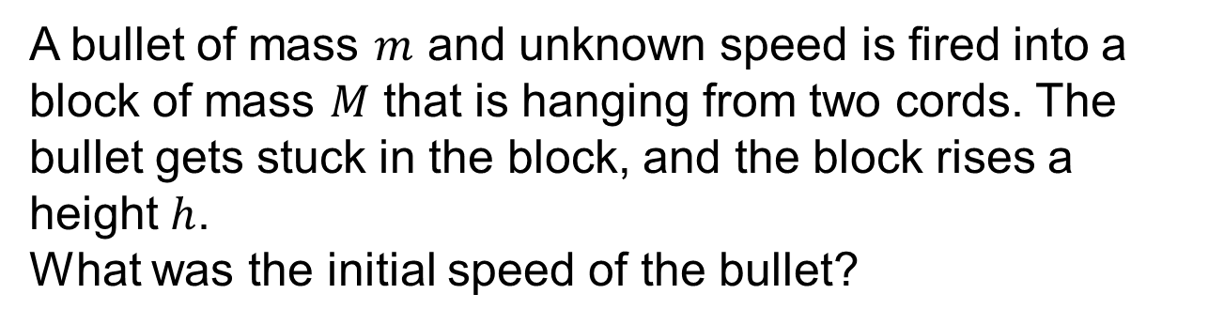
Example: Ballistic pendulum
A bullet of mass $m$ and unknown speed is fired into a block of mass $M$ that is hanging from two cords. The bullet gets stuck in the block, and the block rises a height $h$.
What was the initial speed of the bullet?

Slide 4
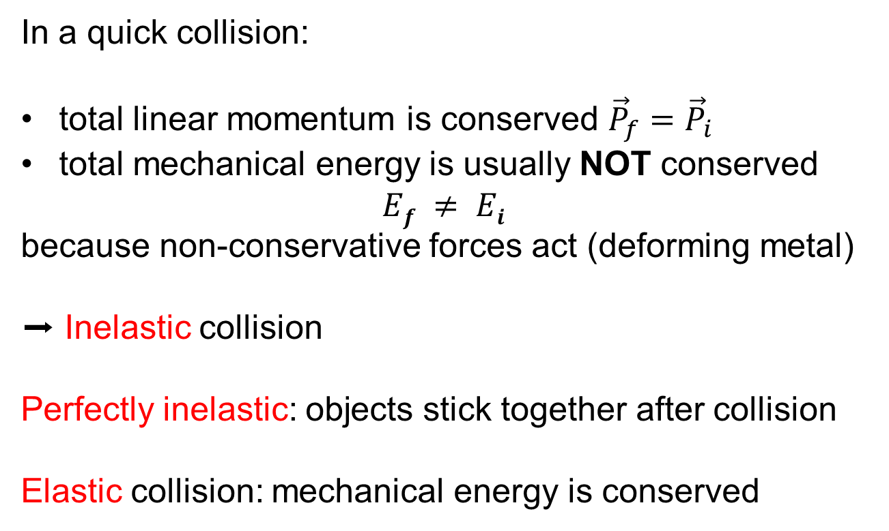
Energy in collisions
In a quick collision:
total linear momentum is conserved ${\vec{P}}_{f}={\vec{P}}_{i}$
total mechanical energy is usually NOT conserved
$$Ef ≠ Ei$$
because non-conservative forces act (deforming metal)
➡ Inelastic collision
Perfectly inelastic: objects stick together after collision
Elastic collision: mechanical energy is conserved

Slide 5

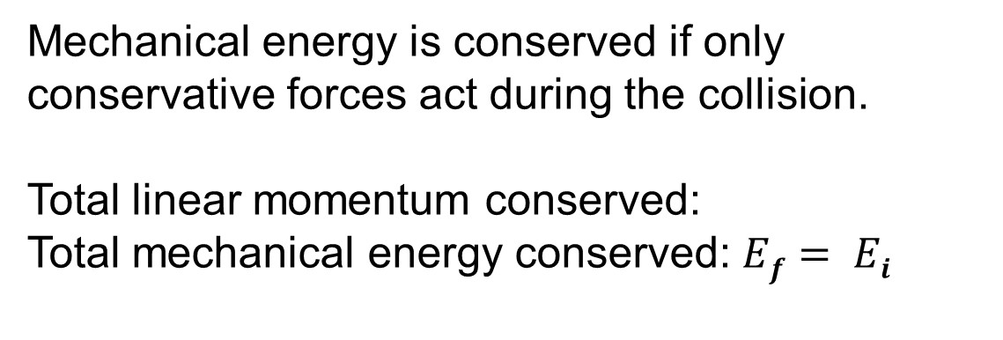
Elastic collisions
Mechanical energy is conserved if only conservative forces act during the collision.
Total linear momentum conserved:
Total mechanical energy conserved: $Ef= Ei$
$${\vec{P}}_{f}={\vec{P}}_{i}$$

Slide 6
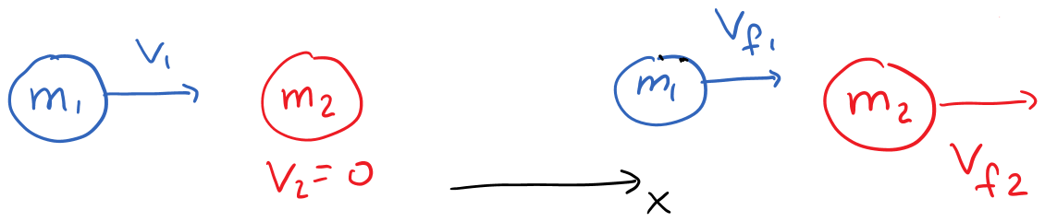
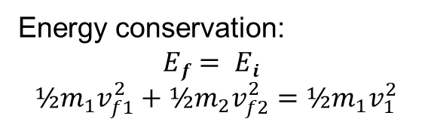
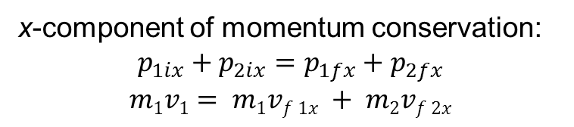
Example: elastic head-on collision with stationary target
x-component of momentum conservation:
$$p_{1ix}+p_{2ix}=p_{1fx}+p_{2fx}$$
$$m1v1= m1vf 1x + m2vf 2x$$
Energy conservation:
$$Ef= Ei$$
$$½m_{1}v_{f1}^{2}+½m_{2}v_{f2}^{2}=½m_{1}v_{1}^{2}$$

Slide 7
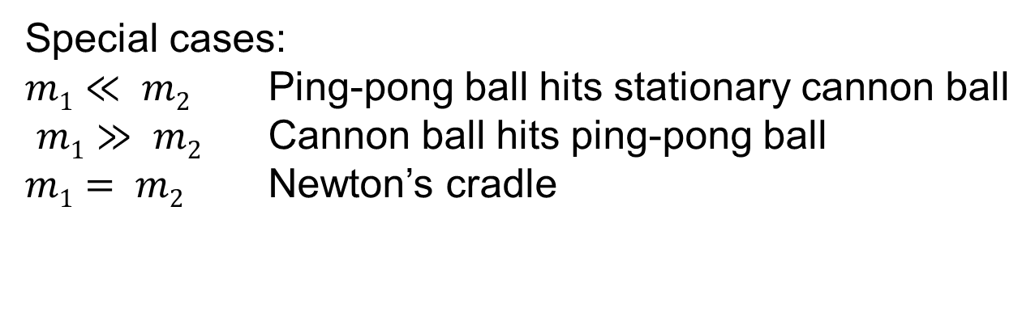
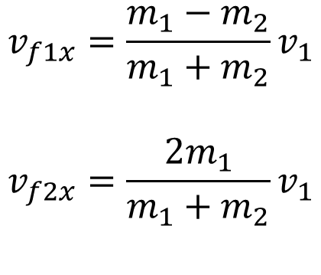
Example continued
After some algebra:
$$v_{f1x}=\frac{m_{1}−m_{2}}{m_{1}+m_{2}}v_{1}$$
$$v_{f2x}=\frac{{2m}_{1}}{m_{1}+m_{2}}v_{1}$$
Special cases:
$m1≪ m2$ Ping-pong ball hits stationary cannon ball
$m1≫ m2$ Cannon ball hits ping-pong ball
$m1= m2$ Newton’s cradle

Slide 8
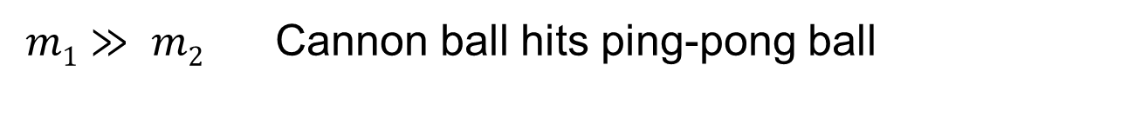
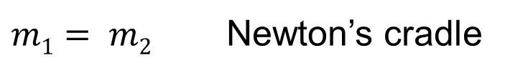
Special cases
$v_{f1x}=\frac{m_{1}−m_{2}}{m_{1}+m_{2}}v_{1}$ $v_{f2x}=\frac{{2m}_{1}}{m_{1}+m_{2}}v_{1}$
$m1≪ m2$ Ping-pong ball hits stationary cannon ball
$v_{f1x}≈−\frac{m_{2}}{m_{2}}v_{1}={−v}_{1}$ $v_{f2x}≈\frac{{2m}_{1}}{m_{2}}v_{1}$
$m1≫ m2$ Cannon ball hits ping-pong ball
$v_{f1x}≈\frac{m_{1}}{m_{1}}v_{1}=v_{1}$ $v_{f2x}≈\frac{{2m}_{1}}{m_{1}}v_{1}=2v_{1}$
$m1= m2$ Newton’s cradle
$v_{f1x}=0$ $v_{f2x}=\frac{2m}{m+m}v_{1}=v_{1}$
Video: Rosencrantz and Guildenstern are dead

Slide 9
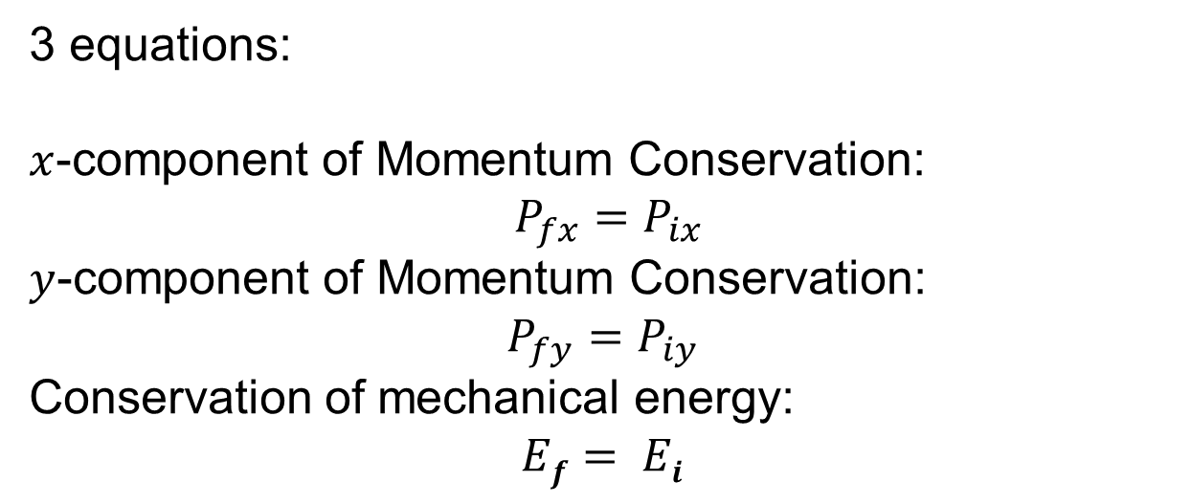
General elastic collisions:
two-dimensional, off-center,
particles move away at angles
3 equations:
$x$-component of Momentum Conservation:
$P_{fx}=P_{ix}$
$y$-component of Momentum Conservation:
$$P_{fy}=P_{iy}$$
Conservation of mechanical energy:
$$Ef= Ei$$

Slide 10
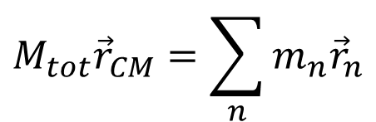
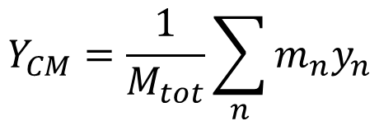
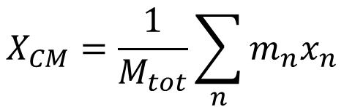
Center of Mass: Definition
$$M_{tot}{\vec{r}}_{CM}=\sum_{n}{m_{n}{\vec{r}}_{n}}$$
$$X_{CM}=\frac{1}{M_{tot}}\sum_{n}{m_{n}x_{n}}$$
$$Y_{CM}=\frac{1}{M_{tot}}\sum_{n}{m_{n}y_{n}}$$
Continuous object: integration
If object has line of symmetry: CM lies on it.
Same amount of mass on both sides.

Slide 11
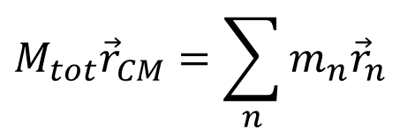
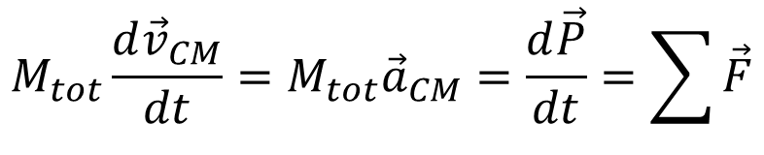
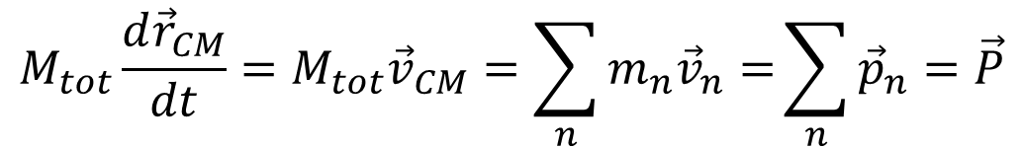
Center of mass and momentum
$$M_{tot}{\vec{r}}_{CM}=\sum_{n}{m_{n}{\vec{r}}_{n}}$$
$${M_{tot}\frac{d{\vec{r}}_{CM}}{dt}=M}_{tot}{\vec{v}}_{CM}=\sum_{n}{m_{n}{\vec{v}}_{n}=}\sum_{n}{{\vec{p}}_{n}=\vec{P}}$$
$${M_{tot}\frac{d{\vec{v}}_{CM}}{dt}=M}_{tot}{\vec{a}}_{CM}=\frac{d\vec{P}}{dt}=\sum{\vec{F}}$$

Slide 12
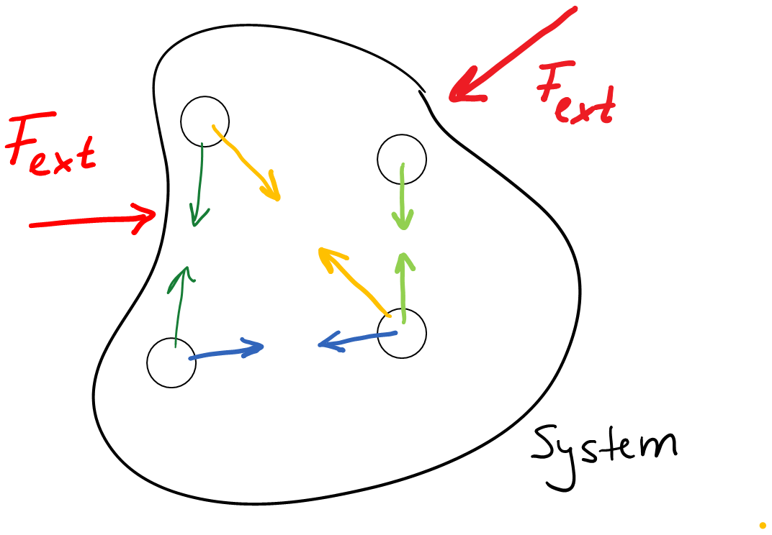
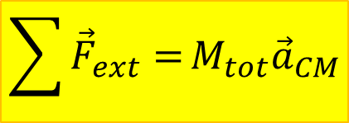
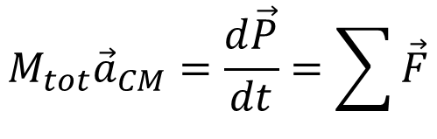
Center of mass and external forces
$$M_{tot}{\vec{a}}_{CM}=\frac{d\vec{P}}{dt}=\sum{\vec{F}}$$
Particles in system interact.
Internal forces occur in
action-reaction pairs, cancel.
Only external forces remain.
$$\sum{{\vec{F}}_{ext}=}M_{tot}{\vec{a}}_{CM}$$
Demo: Center-of-mass motion

Slide 13

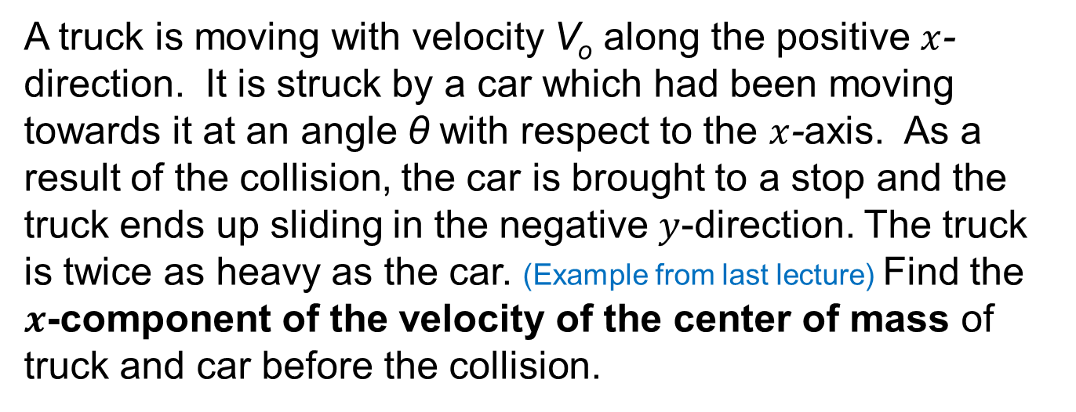
Discussion question
A truck is moving with velocity V_{o} along the positive $x$-direction. It is struck by a car which had been moving towards it at an angle θ with respect to the $x$-axis. As a result of the collision, the car is brought to a stop and the truck ends up sliding in the negative $y$-direction. The truck is twice as heavy as the car. (Example from last lecture) Find the $x$-component of the velocity of the center of mass of truck and car before the collision.

Slide 14
Another discussion question
You find yourself in the middle of a frictionless frozen lake.
How do you get to the shore?
Throw something
Same principle as rocket motion
Demo: rocket cart

