Slide 1
Lecture 19:
Problem Solving Review
For test 2

Slide 2
Concepts Work and Energy
Definition and sign of work
Force perpendicular to path does zero work
Conservative force: work independent of path
Force component as negative derivative of potential energy
Potential energy diagrams
Energy problems

Slide 3
Concepts Universal Gravitation
Free fall acceleration
Satellite motion
Escape speed
Space travel

Slide 4
Concepts Momentum and Impulse
Impulse = change in momentum vector
Inelastic, perfectly inelastic, elastic collisions
Center of mass motion under external forces
Problems for momentum conservation in collisions and explosions

Slide 5
Concepts Static Fluids
Pressure increase with depth
Pascal’s principle
Buoyancy

Slide 6
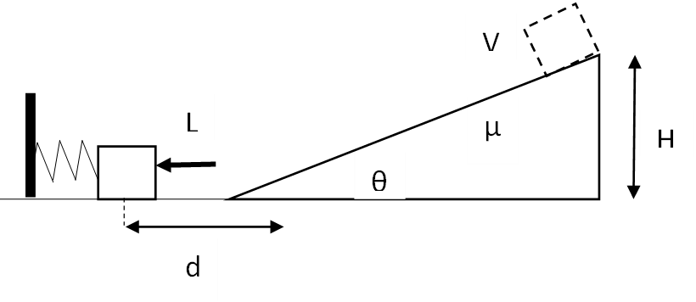
Example 1
A block of mass M is pushed against a spring with unknown spring constant, compressing it a distance L. When the block is released from rest, it travels a distance d on a frictionless horizontal surface and then up a rough incline that has a coefficient of kinetic friction µ with the box. The incline makes an angle θ above the horizontal. When the block reaches height H on the incline, its speed is V.
Derive an expression for the force constant k of the spring in terms of system parameters.

Slide 7
Example 2
Planet A has mass 4M and radius 2R. Planet B has mass 3M and radius R. They are separated by center-to-center distance 8R. A rock of mass m is placed halfway between their centers at point O and released from rest. (Ignore any motion of the planets.)
Derive an expression for the magnitude and direction of the acceleration of the rock at the moment it is released.

Slide 8
Derive an expression, in terms of relevant system parameters, for the speed with which the rock crashes into a planet.

Slide 9
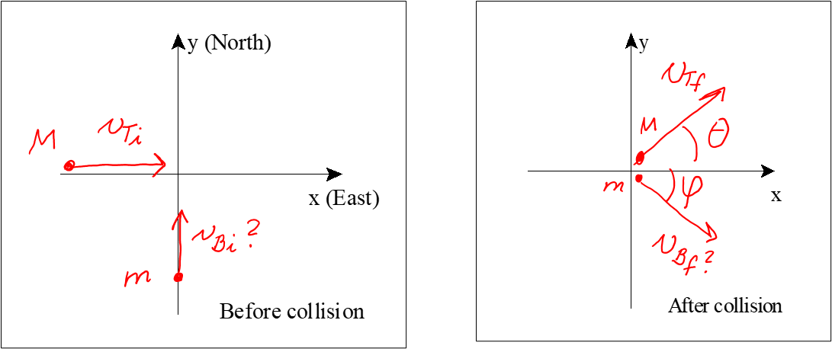
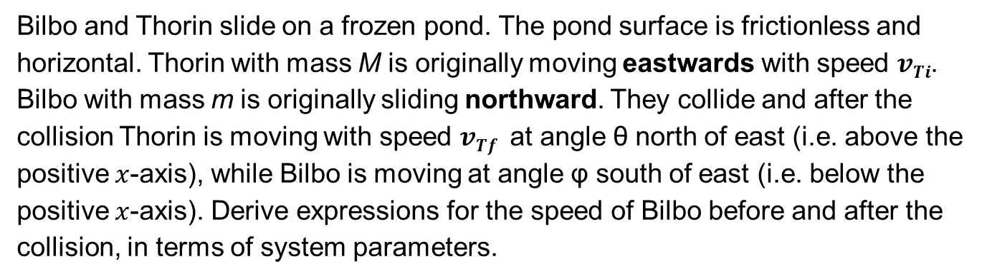
Example 3
Bilbo and Thorin slide on a frozen pond. The pond surface is frictionless and horizontal. Thorin with mass M is originally moving eastwards with speed $vTi$. Bilbo with mass m is originally sliding northward. They collide and after the collision Thorin is moving with speed $vTf$ at angle θ north of east (i.e. above the positive $x$-axis), while Bilbo is moving at angle φ south of east (i.e. below the positive $x$-axis). Derive expressions for the speed of Bilbo before and after the collision, in terms of system parameters.

Slide 10
Problem 2 ctd
Derive an expression for the average force exerted on Thorin by Bilbo in unit vector notation, if the two are in contact for a time span Δt.

