Slide 1
Lecture 20:
Rotational kinematics and energetics
Angular quantities
Rolling without slipping
Rotational kinetic energy
Moment of inertia
Energy problems

Slide 2
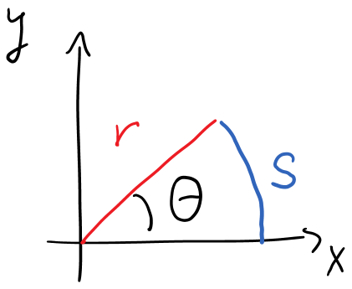
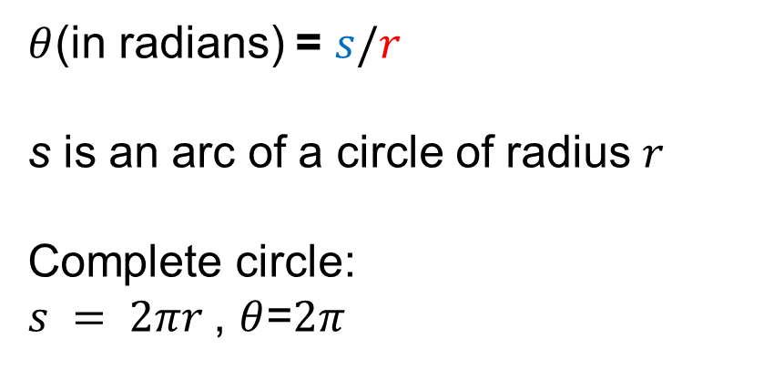
Angle measurement in radians
$θ$(in radians) = $s/r$
s is an arc of a circle of radius $r$
Complete circle:
$s = 2πr$, $θ$=$2π$

Slide 3
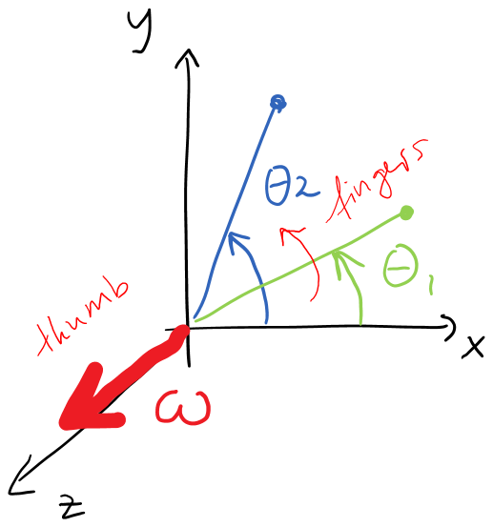
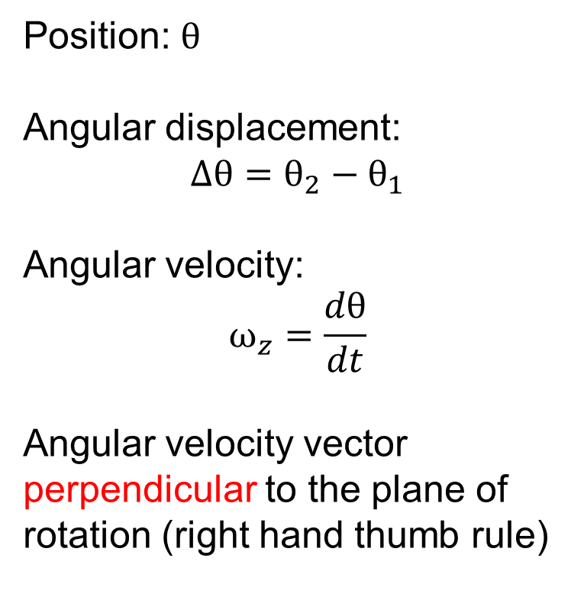
Angular Kinematic Vectors
Position: $θ$
Angular displacement:
$$Δθ=θ_{2}−θ_{1}$$
Angular velocity:
$$ω_{z}=\frac{dθ}{dt}$$
Angular velocity vector
perpendicular to the plane of rotation (right hand thumb rule)

Slide 4
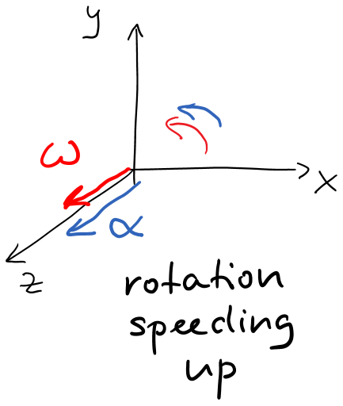
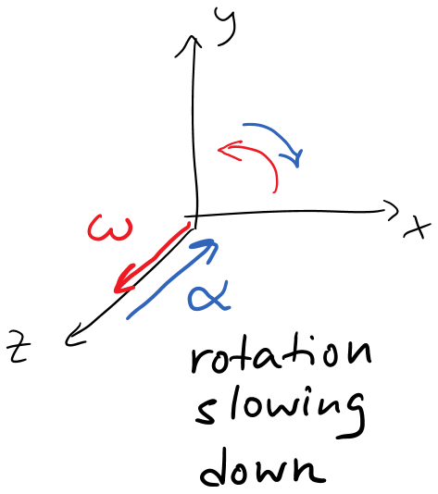
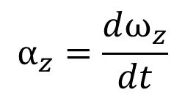
Angular acceleration
$$α_{z}=\frac{dω_{z}}{dt}$$

Slide 5


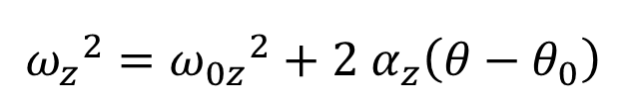
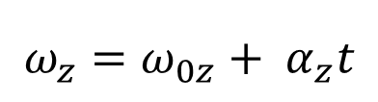

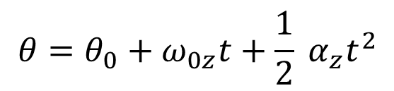

Angular kinematics
For constant angular acceleration:
Compare constant $a_{x}$:
$$θ=θ_{0}+ω_{0z}t+\frac{1}{2} α_{z}t^{2}$$
$$x=x_{0}+v_{0x}t+½a_{x}t^{2}$$
$$v_{x}=v_{0x}+a_{x}t$$
$$ω_{z}=ω_{0z}+ α_{z}t$$
$${ω_{z}}^{2}={ω_{0z}}^{2}+2 α_{z}\left(θ−θ_{0}\right)$$
$$v_{x}^{2}=v_{0x}^{2}+{2a}_{x}(x−x_{0})$$

Slide 6
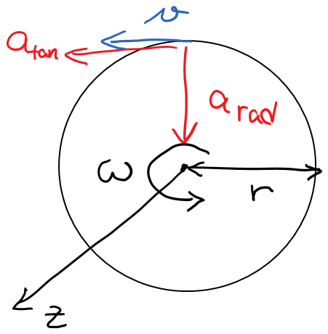

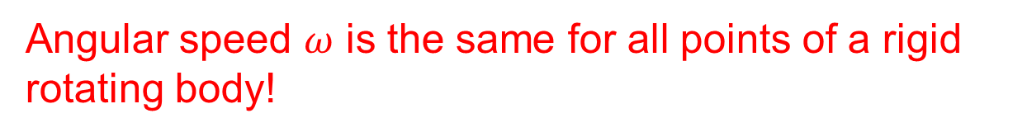
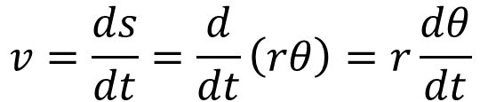

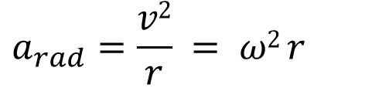
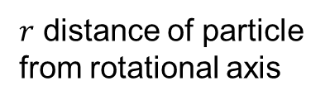
Relationship between angular and linear motion
linear velocity tangent to circular path:
$$v=\frac{ds}{dt}=\frac{d}{dt}\left(rθ\right)=r\frac{dθ}{dt}$$
$$v=ωr$$
$$a_{tan}=αr$$
$$a_{rad}=\frac{v2}{r} = ω2 r$$
$r$ distance of particle
from rotational axis
Angular speed $ω$ is the same for all points of a rigid rotating body!

Slide 7
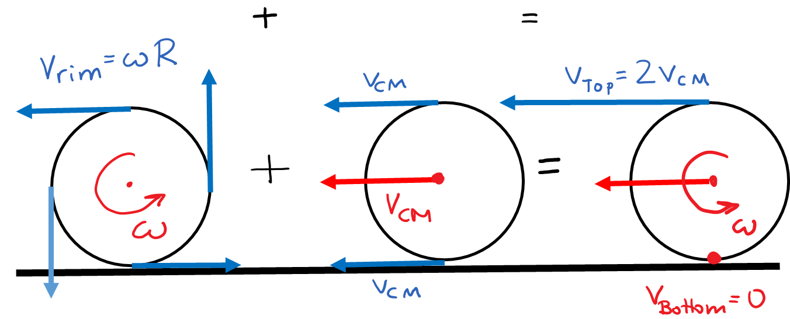
Rolling without slipping
Rotation about CM
Translation of CM
Rolling w/o slipping
If$v_{rim}=v_{CM}:$ $v_{bottom}=0$ no slipping
$$v_{CM}=ωR$$
$$a_{CM}=αR$$

Slide 8

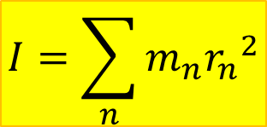
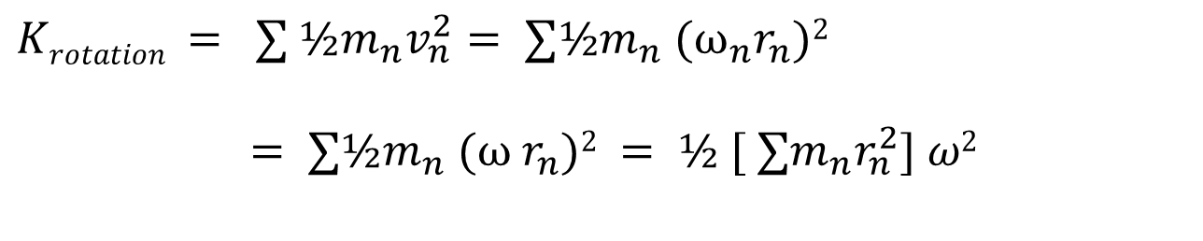
Rotational kinetic energy
$$Krotation = ∑ ½m_{n}v_{n}^{2}= ∑½m_{n} (ω_{n}r_{n})2$$
$$= ∑½m_{n} (ω{ r}_{n})2 = ½ [ ∑m_{n}r_{n}^{2}] ω2$$
$$Krot = ½ I ω2$$
$$I=\sum_{n}{m_{n}{r_{n}}^{2}}$$
with
Moment of inertia

Slide 9
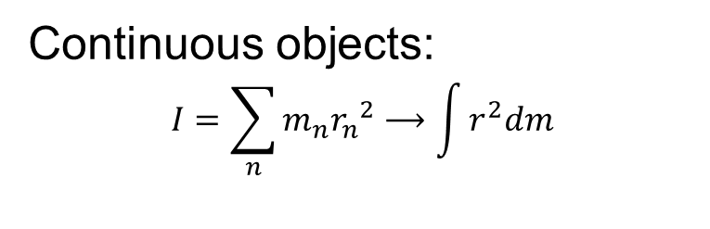
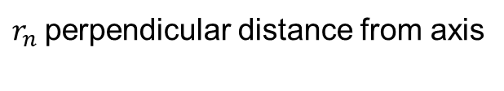
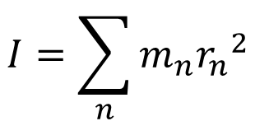
Moment of inertia
$$I=\sum_{n}{m_{n}{r_{n}}^{2}}$$
$r_{n}$perpendicular distance from axis
Continuous objects:
$$I=\sum_{n}{m_{n}{r_{n}}^{2}}⟶\int{r^{2}dm}$$
Table p. 291
* No calculation of moments of inertia
by integration in this course.

Slide 10
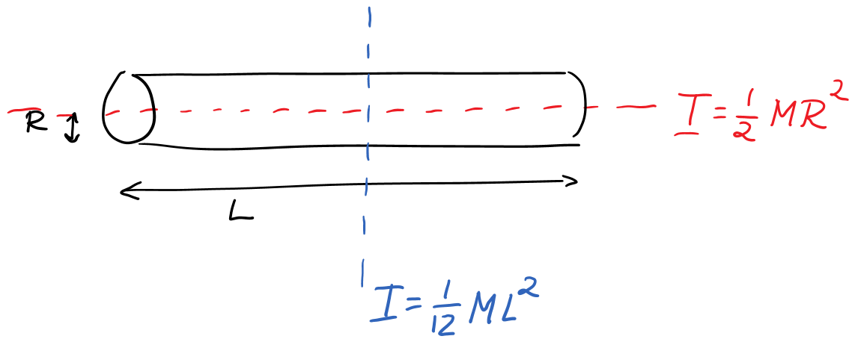
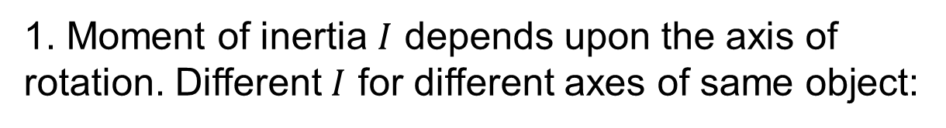
Properties of the moment of inertia
1. Moment of inertia $I$ depends upon the axis of rotation. Different $I$ for different axes of same object:

Slide 11
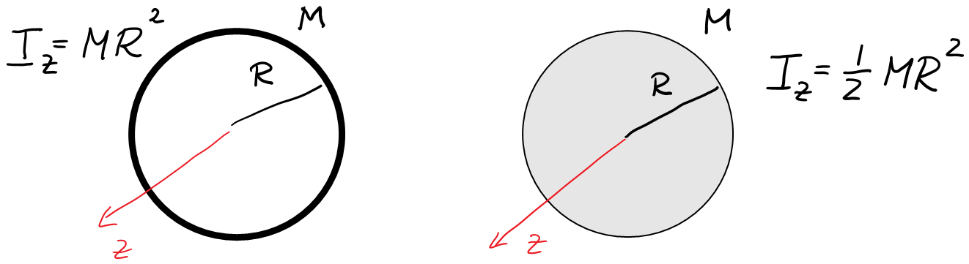
Properties of the moment of inertia: 2.
2. The more mass is farther from the axis of rotation, the greater the moment of inertia.
Example:
Hoop and solid disk of the same radius R and mass M.

Slide 12
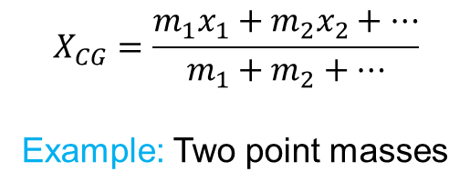
Properties of the moment of inertia: 3.
3. It does not matter where mass is along the rotation axis, only radial distance $rn$ from the axis counts.
Example:
$I$ for cylinder of mass $M$ and radius $R$: $I=½MR2$
same for long cylinders and short disks

Slide 13
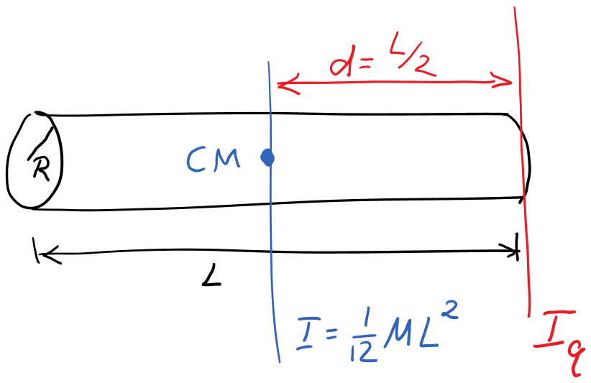
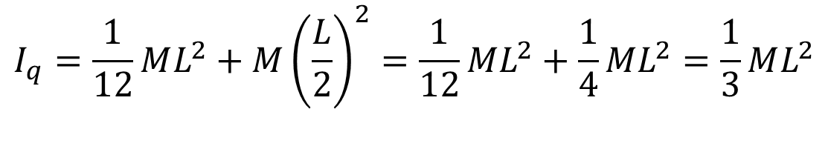

Parallel axis theorem
$$I_{q}=I_{cm||q}+Md^{2}$$
d is the distance between axis and center of mass.
Example:
$$I_{q}=\frac{1}{12}ML^{2}+M{\left(\frac{L}{2}\right)}^{2}=\frac{1}{12}ML^{2}+\frac{1}{4}ML^{2}=\frac{1}{3}ML^{2}$$

Slide 14

Rotation and translation
$$K=K_{trans}+Krot =½Mv_{CM}^{2}+ ½ I ω2$$
$$v_{CM}=ωR$$
with

Slide 15
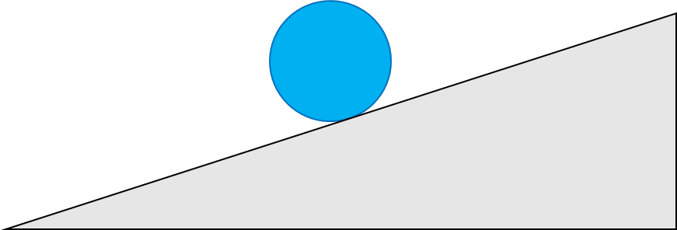
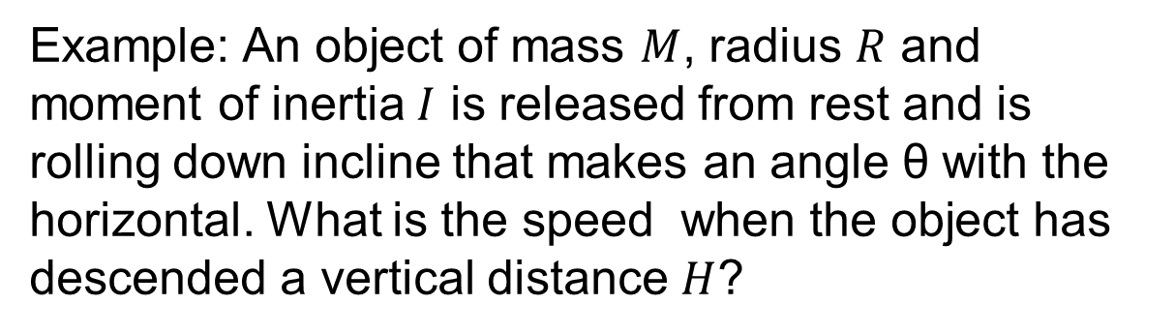
Hoop-disk-race
Demo: Race of hoop and disk down incline
Example: An object of mass $M$, radius $R$ and moment of inertia $I$ is released from rest and is rolling down incline that makes an angle θ with the horizontal. What is the speed when the object has descended a vertical distance $H$?

Slide 16
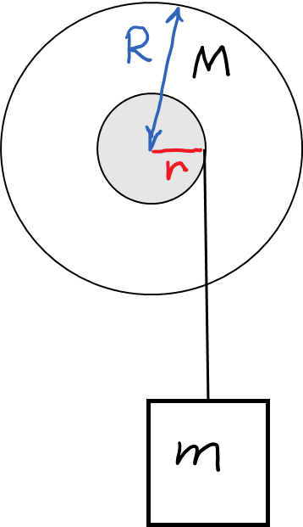
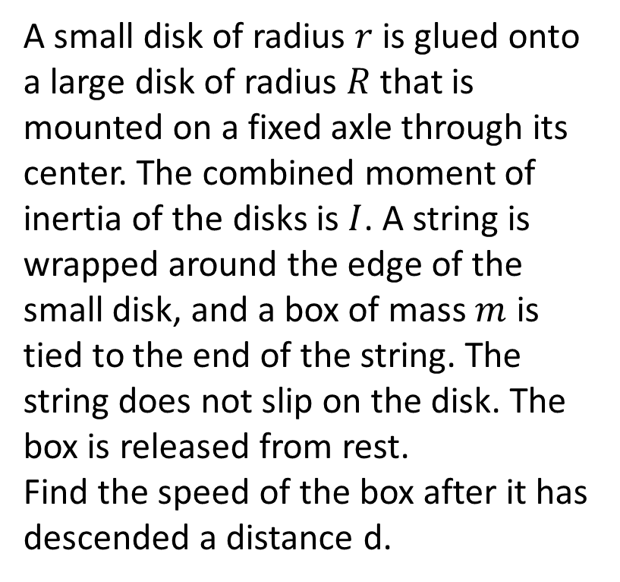
Example with coupled objects
A small disk of radius $r$is glued onto a large disk of radius $R$ that is mounted on a fixed axle through its center. The combined moment of inertia of the disks is $I$. A string is wrapped around the edge of the small disk, and a box of mass $m$ is tied to the end of the string. The string does not slip on the disk. The box is released from rest.
Find the speed of the box after it has descended a distance d.

