Slide 1
Lecture 21:
Torque
Cross product
Torque
Relationship between torque and angular acceleration
Problem solving

Slide 2
What causes rotation?
Demo: bolt and wrench
Need:
Force
Distance
Perpendicular component

Slide 3
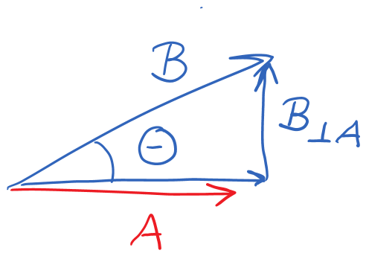
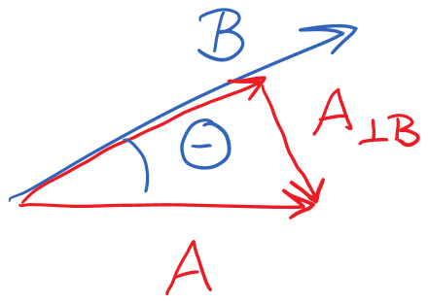
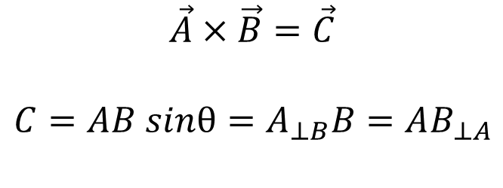
Vector cross product: magnitude
$$\vec{A}×\vec{B}=\vec{C}$$
$$C=AB sinθ=A_{⊥B}B=AB_{⊥A}$$

Slide 4
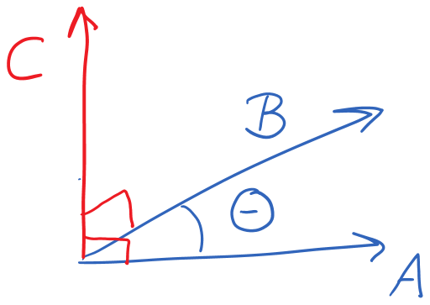
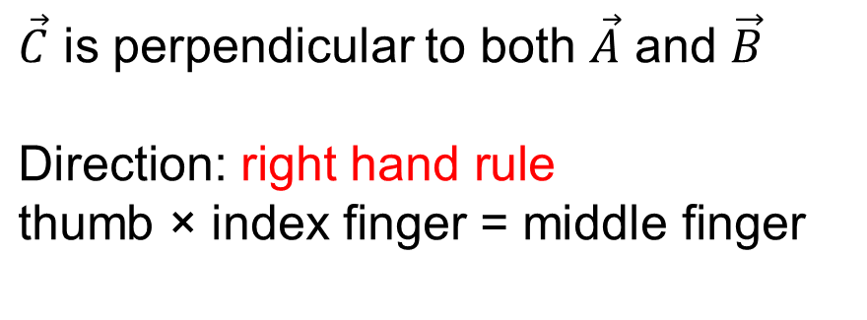

Vector cross product: Direction
$$\vec{A}×\vec{B}=\vec{C}$$
$\vec{C}$ is perpendicular to both $\vec{A}$ and $\vec{B}$
$$\text{Direction}\text{: }\text{right} \text{hand} \text{rule}$$
$$\text{thumb}\text{ × }\text{index} \text{finger}\text{ = }\text{middle} \text{finger}$$

Slide 5
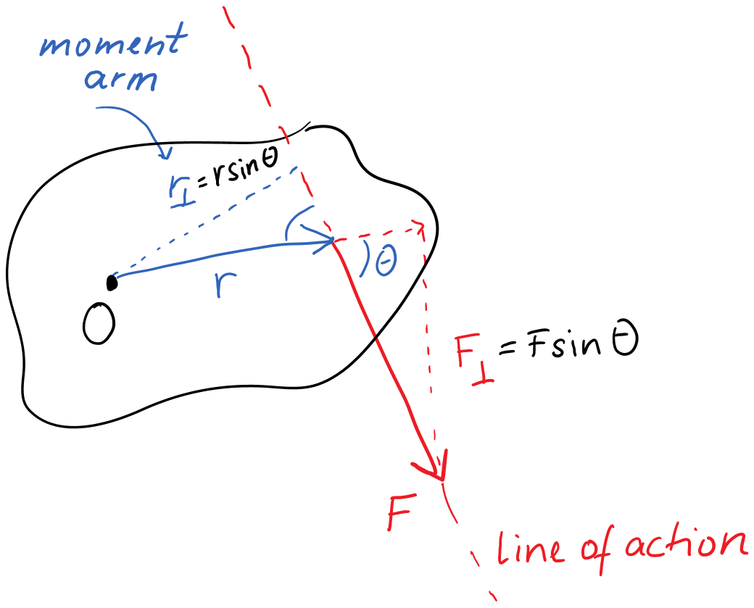

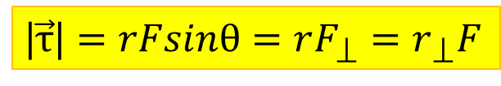
Torque
$$\vec{τ}=\vec{r}×\vec{F}$$
|$\vec{τ}\text{|}=rFsinθ=rF_{⟘}=r_{⟘}F$

Slide 6
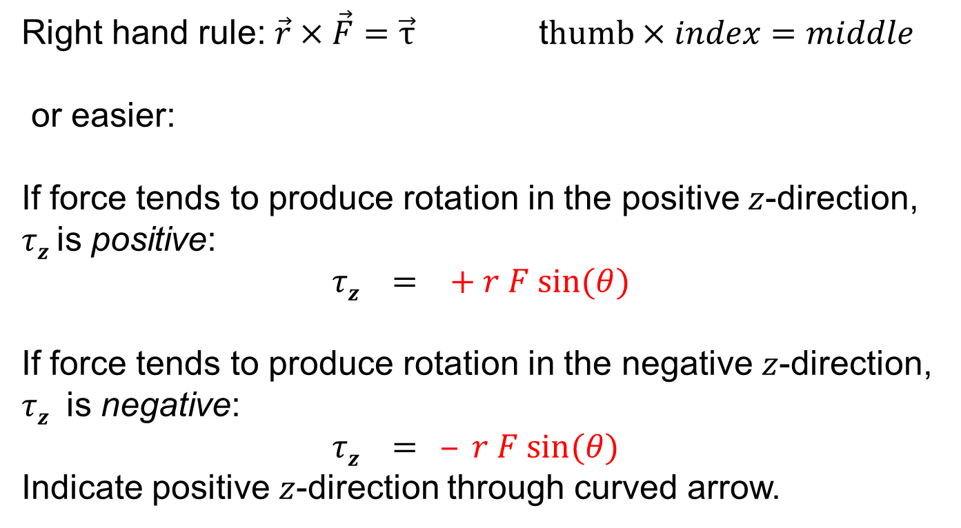
Direction of torque
Right hand rule: $\vec{r}×\vec{F}=\vec{τ}$ t$humb×index=middle$
or easier:
If force tends to produce rotation in the positive $z$-direction, $τz$is positive:
$τz = + r F sin⁡(θ)$
If force tends to produce rotation in the negative $z$-direction, $τz$ is negative:
$τz = ‒ r F sin⁡(θ)$
Indicate positive $z$-direction through curved arrow.

Slide 7
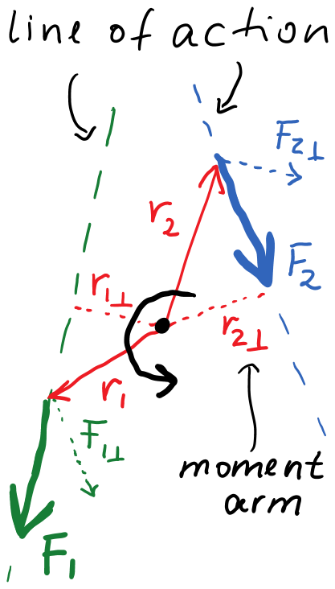


Sign of torque component
$${τ }_{1z}=+F_{1}r_{1⊥}=+F_{1⊥}r_{1}$$
$${τ }_{2z}=−F_{2}r_{2⊥}=−F_{2⊥}r_{2}$$
Curved arrow indicates positive z-direction Curl right-hand fingers; z-direction is thumb.

Slide 8
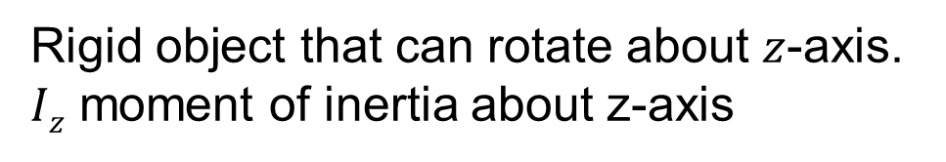
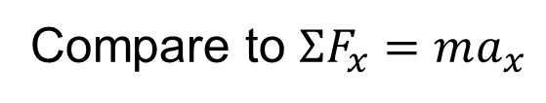
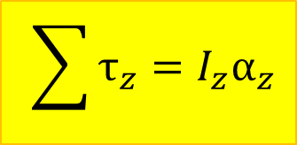
Angular acceleration of rigid object
Rigid object that can rotate about $z$-axis.
$Iz$ moment of inertia about z-axis
$$\sum{τ_{z}=I_{z}α_{z}}$$
Compare to $ΣF_{x}=ma_{x}$
Begin with extended free-body diagram that shows forces
and where they act on the object

Slide 9
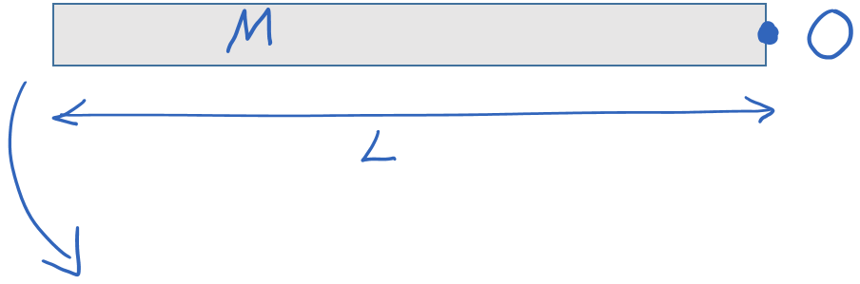
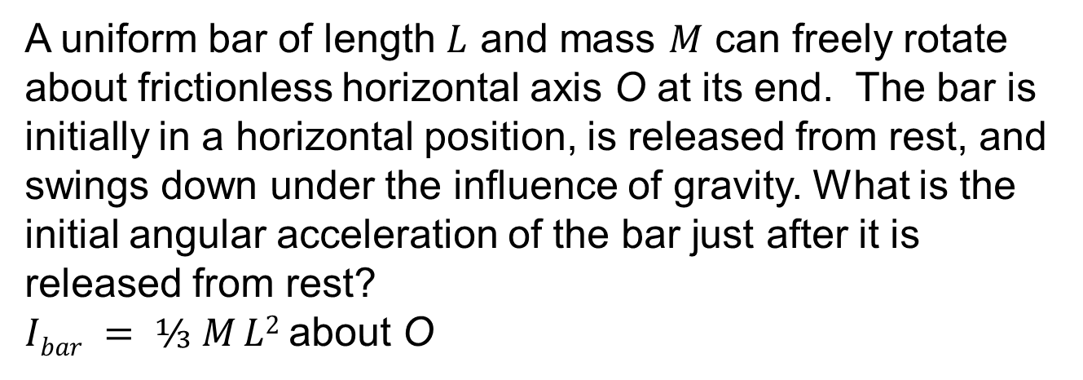
Example 1:
A uniform bar of length $L$ and mass $M$ can freely rotate about frictionless horizontal axis O at its end. The bar is initially in a horizontal position, is released from rest, and swings down under the influence of gravity. What is the initial angular acceleration of the bar just after it is released from rest?
$Ibar = ⅓ M L2$about O

Slide 10
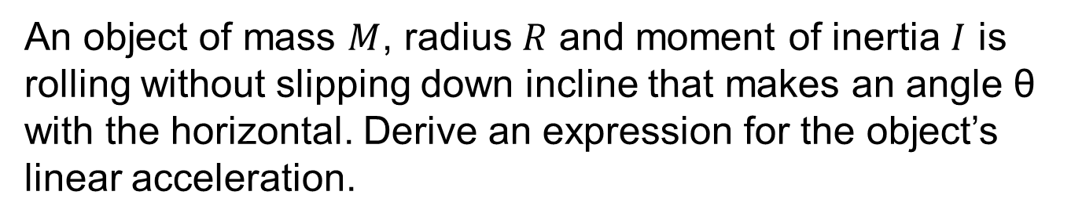
Example 2: Rolling w/o slipping
An object of mass $M$, radius $R$ and moment of inertia $I$ is rolling without slipping down incline that makes an angle θ with the horizontal. Derive an expression for the object’s linear acceleration.

Slide 11
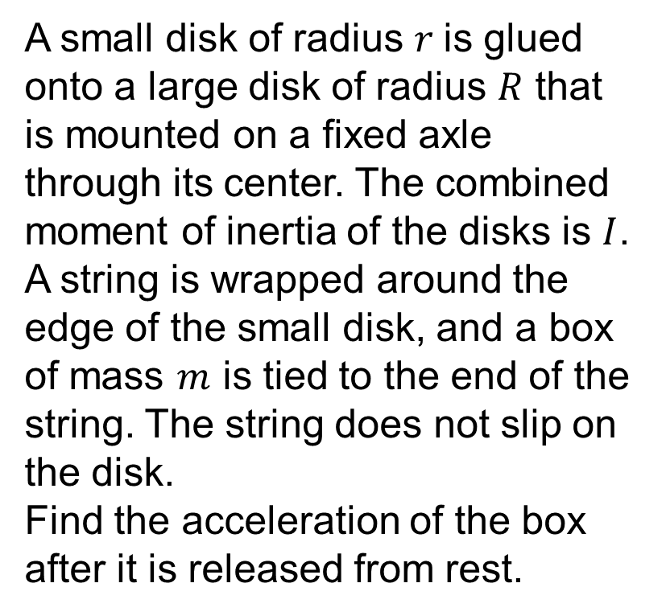


Example 3: Coupled objects
A small disk of radius $r$is glued onto a large disk of radius $R$ that is mounted on a fixed axle through its center. The combined moment of inertia of the disks is $I$. A string is wrapped around the edge of the small disk, and a box of mass $m$ is tied to the end of the string. The string does not slip on the disk.
Find the acceleration of the box after it is released from rest.

