Slide 1
Lecture 22:
Static Equilibrium
Conditions for static equilibrium
Examples

Slide 2
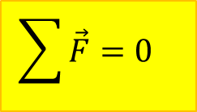
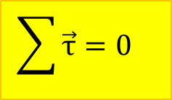
Conditions for static equilibrium
No linear acceleration:
$$\sum{\vec{F}=0 }$$
No angular acceleration:
$$\sum{\vec{τ}=0 }$$

Slide 3
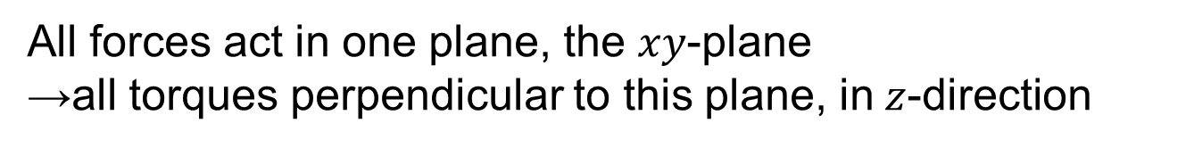
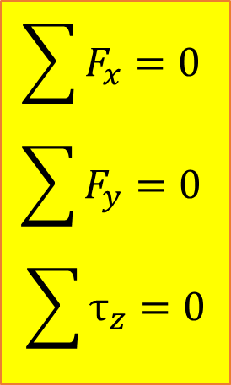
Two-dimensional problems
All forces act in one plane, the $xy$-plane
→all torques perpendicular to this plane, in$z$-direction
$$\sum{F_{x}=0 }$$
$$\sum{F_{y}=0 }$$
$$\sum{τ_{z}=0}$$

Slide 4
Choice of reference point for torques
Object does not rotate → may choose any point about which to calculate torques.
Reference point along the line of action of a force: moment arm is zero →no torque
Convenient choice of reference point:
point where several forces act
point where unknown force acts

Slide 5
Easy Example:
Father and son on see-saw
Father (mass m₁) and son (mass m₂) are on a see-saw, which is a beam of mass M and length L that is pivoted in the middle. The son sits at one end. How far from the middle does the father have to sit for the see-saw to be in equilibrium?

Slide 6
Example 2
A massless beam of length L has its lower end pivoted at P on the floor, making an angle θ with the floor. A horizontal cable is attached from its upper end E to a point A on a nearby wall. A rope is attached at one-fourth of the way down from the beam’s upper end, and hangs vertically downward. A disgustingly cheery purple dinosaur of mass M is attached motionless to the end of the rope.
Derive an expression for the tension in the horizontal cable AE.
What are the x and y components of the force exerted by the pivot on the lower end of the beam?

Slide 7
Complex example
A uniform beam of length L and weight W is set upright on a rough floor which has a coefficient of static friction μ with the beam. A constant, horizontal pulling force is applied to the beam at some height above the ground. A rope which makes an angle θ with the beam is attached to the top end of the beam. The tension in the rope is T. The lower end of the beam is just about to slide.
T
θ
W
L
µ
h?
Derive an expression for the height h above the ground at which the pulling force is applied, in terms of relevant system parameters.

