Slide 1
Lecture 28: Wave interference
Superposition of waves
Standing waves on a string
Interference

Slide 2
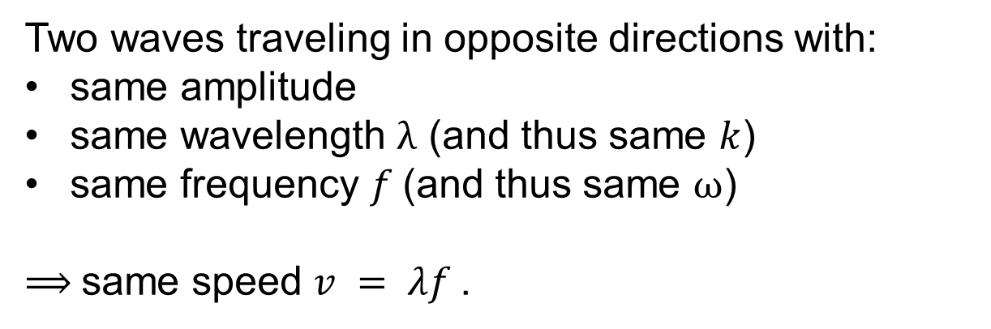
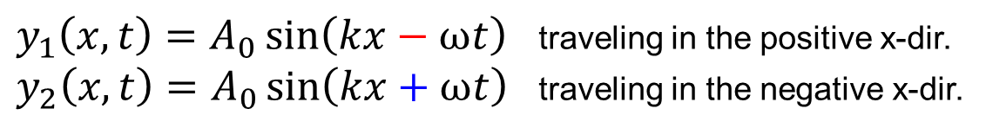
Standing Waves
Two waves traveling in opposite directions with:
same amplitude
same wavelength λ (and thus same $k$)
same frequency $f$(and thus same ω)
⟹ same speed $v = λf$.
$y_{1}\left(x,t\right)=A_{0}\sin\left(kx−ωt\right)$ traveling in the positive x-dir.
$y_{2}\left(x,t\right)=A_{0}\sin\left(kx+ωt\right)$ traveling in the negative x-dir.

Slide 3

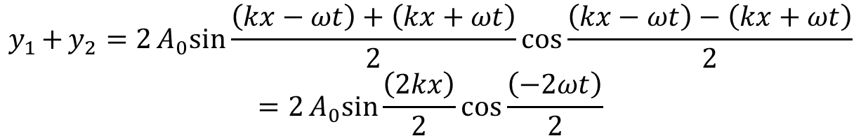

Equation for Standing Waves
$y_{1}\left(x,t\right)=A_{0}\sin\left(kx−ωt\right)$ traveling in the positive x-dir.
$y_{2}\left(x,t\right)=A_{0}\sin\left(kx+ωt\right)$ traveling in the negative x-dir.
$$\sin{a+\sin{b=2\sin{\frac{a+b}{2}\cos{\frac{a−b}{2}}}}}$$
$$y_{1}{+y_{2}{=2A_{0}sin{\frac{\left(kx−ωt\right)+\left(kx+ωt\right)}{2}\cos{\frac{\left(kx−ωt\right)−\left(kx+ωt\right)}{2}}}}}$$
$$=2A_{0}sin{\frac{\left(2kx\right)}{2}\cos{\frac{\left(−2ωt\right)}{2}}}$$
$$y\left(x,t\right)=y_{1}+y_{2}=2A_{0}\sin\left(kx\right)\cos\left(ωt\right)$$
Standing wave

Slide 4
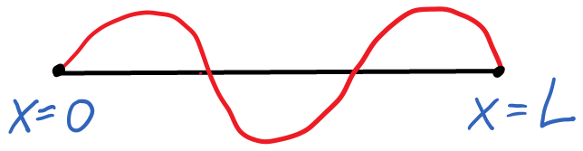
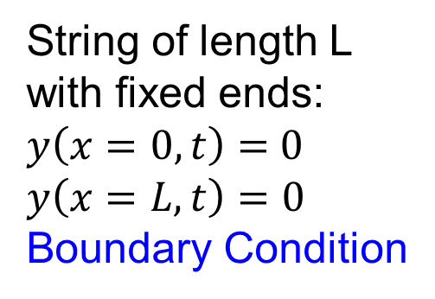
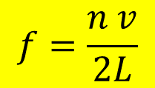
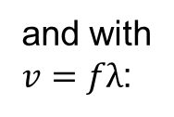
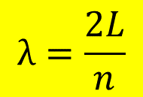

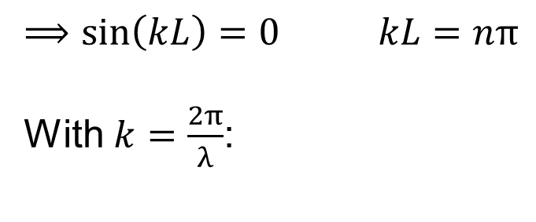
Standing wave on a string
$$y\left(x,t\right)=A\sin\left(kx\right)\cos\left(ωt\right)$$
String of length L
with fixed ends:
$y\left(x=0,t\right)=$ 0
$$y\left(x=L,t\right)=0$$
Boundary Condition
$⟹\sin\left(kL\right)=0$ $kL=nπ$
With $k=\frac{2π}{λ}$:
$$λ=\frac{2L}{n}$$
and with
$v=fλ$:
$$f=\frac{n v}{2L}$$

Slide 5
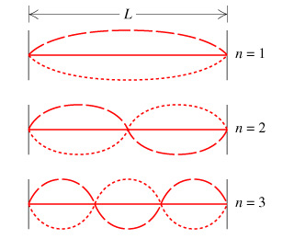
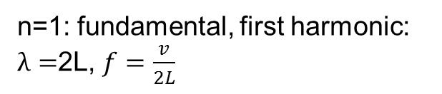


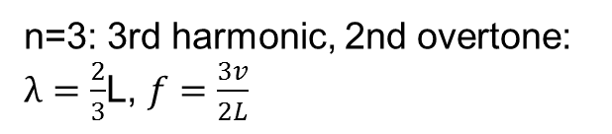

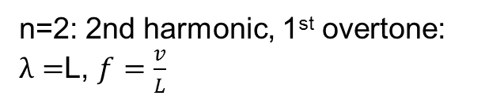
Fundamental frequency and harmonics
String of length L
with fixed ends
$$λ=\frac{2L}{n}$$
$$f=\frac{n v}{2L}$$
n=1: fundamental, first harmonic: $λ=$2L, $f=\frac{v}{2L}$
n=2: 2nd harmonic, 1st overtone: $λ=$L, $f=\frac{v}{L}$
n=3: 3rd harmonic, 2nd overtone: $λ=\frac{2}{3}$L, $f=\frac{3v}{2L}$

Slide 6
Example 1
A wire has a length of 8m. The speed of waves on the wire
is 240m/s. What is the fundamental frequency?

Slide 7

Example 2
A particular guitar string has a mass of 3.0 grams and a length of 0.75 m. A standing wave on the string has the shape shown in the figure. The wave has a frequency of 1200 Hz.
(a) What is the speed of the wave?
(b) What is the tension of the string?
(c) The wave on the string produces a sound wave. Does the sound wave have the same frequency, wavelength, or speed as the wave on the string?

Slide 8
Interference
Two or more
traveling waves
superimpose:
interference

Slide 9


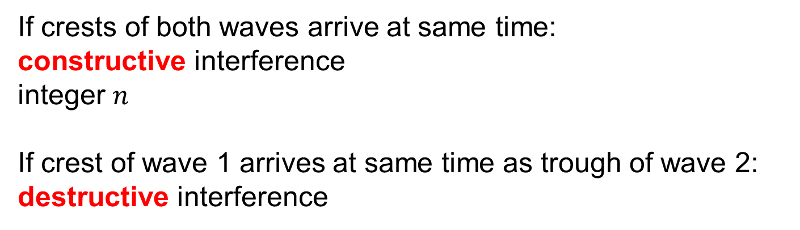
Interference and path length
Two sources, waves emitted in phase. How do waves combine at P?
If crests of both waves arrive at same time:
constructive interference
integer $n$
If crest of wave 1 arrives at same time as trough of wave 2:
destructive interference
$\left|L_{1}−L_{2}\right|=ΔL=nλ$
$\left|L_{1}−L_{2}\right|=ΔL=\left(n+½\right) λ$

Slide 10
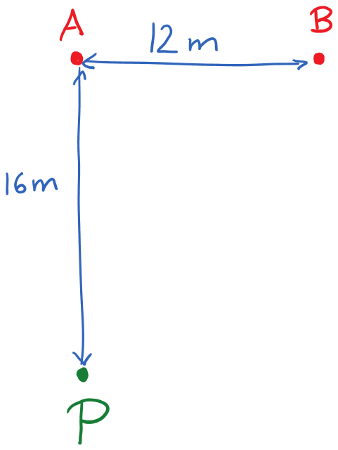
Example 3
Two radio transmitters (A and B) are 12 m apart. They are driven by the same oscillator (i.e., they emit in phase) and generate waves of wavelength 2 m. How do the waves interfere at point P that is 16 m directly in front of source A?

Slide 11
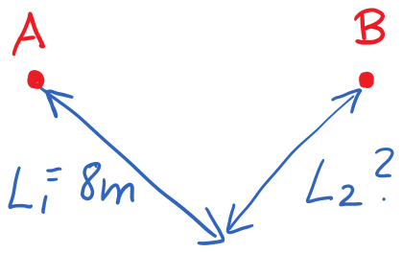
Example 4
Two loudspeakers emit waves of frequency 172 Hz. The speed of sound is 344 m/s. You are 8 m from speaker A. How close can you get to speaker B and have destructive interference?

